Slide 1
Mindfulness for Everyday
Chattanooga Autism Conference
April 20, 2018
Christy Tittsworth, APRN, CPNP, PMHS, BCN

Slide 2
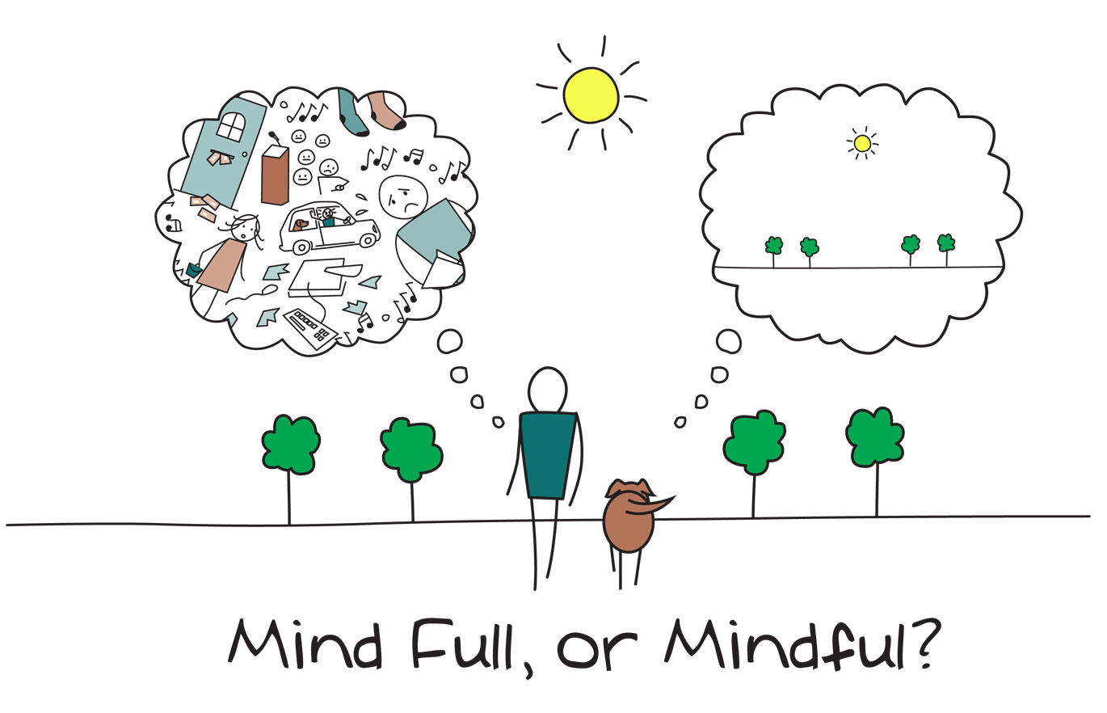

Slide 4
Areas of the Brain Affected by Mindfulness
Rostrolateral prefrontal cortex: A region associated with meta-awareness (awareness of how you think), introspection, and processing of complex, abstract information.
Sensory cortices and insular cortex: The main cortical hubs for processing of tactile information such touch, pain, conscious proprioception, and body awareness.
Hippocampus: A pair of subcortical structures involved in memory formation and facilitating emotional responses.
Anterior cingulate cortex and mid-cingulate cortex: Cortical regions involved in self-regulation, emotional regulation, attention, and self-control.
Superior longitudinal fasciculus and corpus callosum: Subcortical white matter tracts that communicate within and between brain hemispheres.

Slide 5
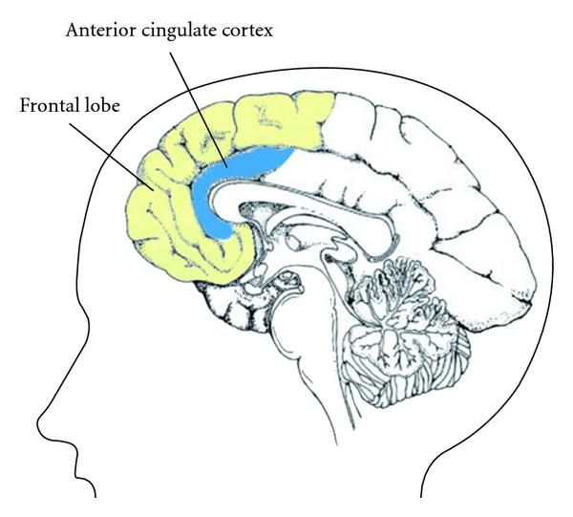

Slide 6
Retrived from: http://stopstressandanxiety.com with credit to groundingyoga.com

Slide 7
Research Summary
Multiple studies in Physical and Mental Health
MBSR is most studied
Metanalysis with 47 trials with 3,515 participants found that people participating in mindfulness meditation programs experienced less anxiety, depression, and pain
Metanalysis with 163 studies found evidence that meditation practice is associated with reduced negative emotions and neuroticism, and the impact of meditation was comparable to the impact of behavioral treatments and psychotherapy on patients
Need larger more controlled studies

Slide 8
Research in Autism
Res Dev Disabil. 2017 May;64:47-55. doi: 10.1016/j.ridd.2017.03.004. Epub 2017 Mar 22.
Cognitive behavioural therapy and mindfulness based stress reduction may be equally effective in reducing anxiety and depression in adults with autism spectrum disorders.
Sizoo BB¹, Kuiper E².
Author information
Abstract
Anxiety and depression co-occur in 50-70% of adults with autism spectrum disorder (ASD) but treatment methods for these comorbid problems have not been systematically studied. Recently, two ASD-tailored protocols were published: mindfulness based stress reduction (MBSR) and cognitive behavioural therapy (CBT). We wanted to investigate if both methods are equally effective in reducing anxiety and depression symptoms among adults with ASD. 59 adults with ASD and anxiety or depression scores above 7 on the Hospital Anxiety and Depression Scale, gave informed consent to participate; 27 followed the CBT protocol, and 32 the MBSR treatment protocol. Anxiety and depression scores, autism symptoms, rumination, and global mood were registered at the start, at the end of the 13-week treatment period, and at 3-months follow-up. Irrational beliefs and mindful attention awareness were used as process measures during treatment and at follow-up. Results indicate that both MBSR and CBT are associated with a reduction in anxiety and depressive symptoms among adults with ASD, with a sustained effect at follow-up, but without a main effect for treatment group. A similar pattern was seen for the reduction of autisticsymptoms, rumination and the improvement in global mood. There are some indications that MBSR may be preferred over CBT with respect to the treatment effect on anxiety when the scores on measures of irrational beliefs or positive global mood at baseline are high. Mindfulnessand cognitive behavioral therapies are both promising treatment methods for reducing comorbid anxiety and depression in adults with ASD

Slide 9
Ancient Mindfulness

Slide 10
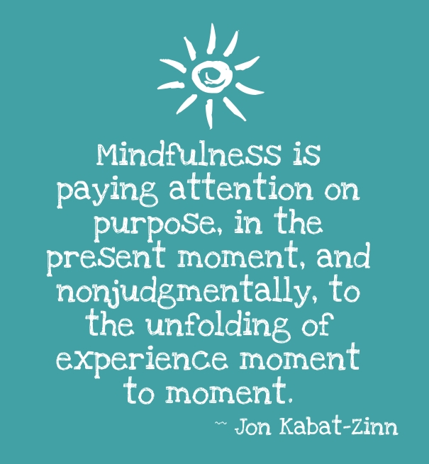

Slide 11
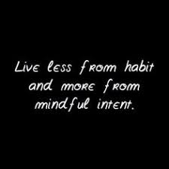
Intention
Illustration by: Anthony Weeks; Retrieved from: http://roychristopher.com/inventing-the-medium-net-smart

Slide 12
Benefits of Mindfulness
Attentional Control
Emotional Self-Regulation
Self-Awareness
Self-Regulation
Stress Reduction
Improved Health and Well Being

Slide 13
Stages of Mindfulness
Early Stage: Effortful doing
Middle Stage: Effort to reduce mind wondering
Advanced Stage: Effortless being

Slide 14
Mindfulness Practices
Mindful Breathing
Mindful Movement or Walking
Mindful Eating
Mindfulness Meditation

Slide 15
Mindful Breathing
Image retrieved from and additional breathing techniques at www.thought-management.com

Slide 16
Mindfulness through Body Awareness
Body Scan
Mindful Walking
Yoga

Slide 17
Mindful Eating
Downloadable placemat from: summertomato.com

Slide 19
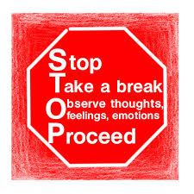

Slide 20
Resources
Center for Mindful Living
Local Yoga Studios and Classes
Your Therapist
Headspace App
Insight Timer App

Slide 21
References
Yi-Yuan Tang, Britta K. Hölzel, and Michael I. Posner. The Neuroscience of Mindfulness Meditation. Nature Reviews Neuroscience. AOP, published online 18 March 2015; doi:10.1038/nrn3916
Sedlmeier, Eberth J, Schwarz M, Zimmermann D, Haarig F, Jaeger S, Kunze S. The psychological effects of meditation: a meta-analysis. Psychological Bulletin 2012 Nov;138(6):1139-71. doi: 10.1037/a0028168. Epub 2012 May 14
Goyal M, Singh S, Sibinga EM, Gould NF, Rowland-Seymour A, Sharma R, Berger Z, Sleicher D, Maron DD, Shihab HM, Ranasinghe PD, Linn S, Saha S, Bass EB, Haythornthwaite JA. Meditation programs for psychological stress and well-being: a systematic review and meta-analysis.JAMA Internal Medicine 2014 Mar;174(3):357-68. doi: 10.1001/jamainternmed.2013.13018.

