Slide 1
ENTREPRENEURSHIP PANEL
CHATTANOOGA AUTISM CTR CONFERENCE
SEPTEMBER 19, 2020
PRESENTATION BY YADIRA V. CALDERON
AND RAINBOW MOSHO

Slide 2
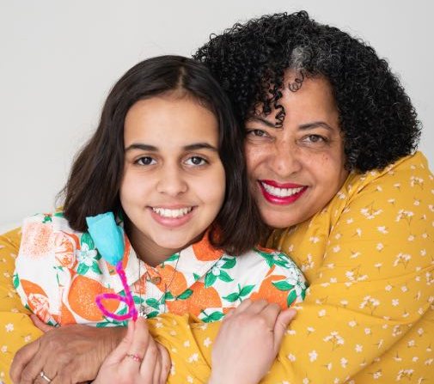
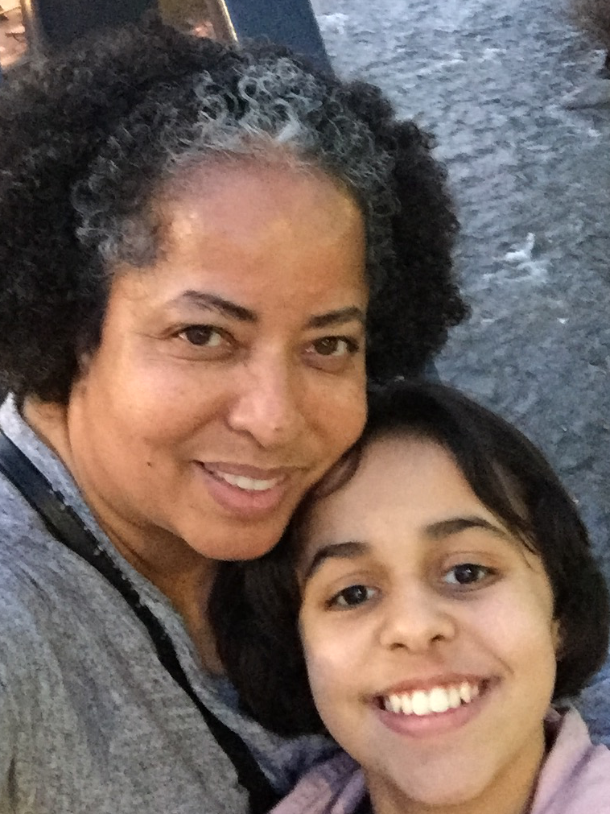
Hello!
I Am YADIRA V. CALDERON
mother of Thomais
I am here because autism drives our day. I believe in seeking quality of life even with the challenges we face.
Background - lived in 6 countries, traveled to another 27, Master of Arts, speak 4 languages, have worked in more than 5 industrieso - different responsibilities.
Firm believer in building community.
You can contact me at rainbowmosho@autismhappykingdom.com

Slide 3
Why Inclusion?
Why Entrepreneurship?
Yadira says: : “If I, the parent, do not emphasize quality of life, while learning from the difficulties we all face in life, my daughter will remain in an unrealistic bubble without skills.”
OECD report says: Promoting entrepreneurship constitutes an important… strategy which treats entrepreneurship as a key component of smart, sustainable and inclusive growth.
https://read.oecd-ilibrary.org/employment/entrepreneurial-activities-in-europe-entrepreneurship-for-people-with-disabilities_5jxrcmkcxjq4-en#page12
Bureau of Labor Statistics: 29 percent of Americans ages 16 to 64 with a disability were employed as of June 2018, compared with nearly 75 percent of those without a disability. Unemployment rate for people with disabilities - actively seeking work is 9.2 percent — more than twice as high as for those without a disability (4.2 percent).

Slide 4
What is your reality?
My child/teen/adult is non-verbal.
My child/teen/adult still wears a diaper.
My child/teen/adult has behavior crisis.
My adult to be will not get a diploma that leads to financial stability.
My teen/adult - social skills limit interaction.
I do not have the funds to start a business.
I have the funds but I do not know what we can do.
Legal consequences.
We do not have family support.
What’s next?

Slide 5
HOW TO ACHIEVE SUCCESS?
MENTORSHIP
CHALLENGES
DRIVE
SUCCESS
ACCOMMODATIONS
Gives access to a network!
Understands steps needed
Has made mistakes
Important tool - not the only one! To be used as needed, not as a crutch!
Verbal, non-verbal
Independent, living at home
KNOW YOUR
CUSTOMERS
SOCIAL MEDIA
SOURCES OF
INFORMATION
Key element that guarantees access to those who will purchase product or service
* Affordable!!
Your product/service is unique and your customer wants it and needs it
Time needed to read a great amount of resources available - local and elsewhere

Slide 6
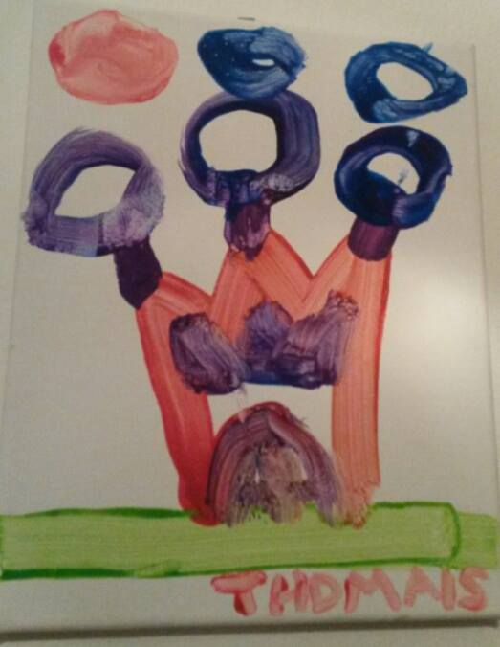
A simple drawing inspires a dream…
Book (to be published)
3D Printed castles
Interviews
Meeting authors
Featured Guests in PBS documentary
Free Parent Workshops
This drawing inspired the story - Autism: The Happy Kingdom

Slide 7
WHERE ARE WE?
You can find us at:
www.autismhappykingdom.com
rainbowmosho@autismhappykingdom.com

Slide 8
OBJECTIVES
Understand the importance of emphasizing the abilities of young people with disabilities.
2. Gain knowledge of organizations providing support to future entrepreneurs.
3. Be able to utilize social media as an empowering tool to promote a product or service.
4. Identify prospective markets based on skills.

Slide 9
Why Inclusion?
Why Entrepreneurship?
Legislator Aims to Change Arkansas' New Minimum Wage Law, Excluding Certain Groups = those with developmental disabilities
Trump Proposes Cuts To Medicaid, Other Disability Programs
500,000 teens with autism will become adults in next 10 years. Where will they work?

Slide 10
WHY ENTREPRENEURSHIP?
STRENGTHS
CHALLENGES
Artist, creative, original
Has a unique product/s
Loves story telling, animals
Great memory
Not afraid to share her story
Family support
No guarantee of government help for the next 30 years
No guarantee my child will go to college
Access to reliable legal support
Social skills, too trusting
Understand the importance of emphasizing the abilities of young people with disabilities.
a. Write your list of strenghts and challenges!

Slide 11
Our Process
Family asking
when will art
be sold
Art Expo in
Nashville with
Borderless Arts
Opportunity -
Art Crawl
Memphis
Organization
practicing
Inclusion
Art sold via social media, art crawls and the webisite-
It happened!
We want more!
What to do?
2. Gain knowledge and interact with organizations providing support to future entrepreneurs.

Slide 12
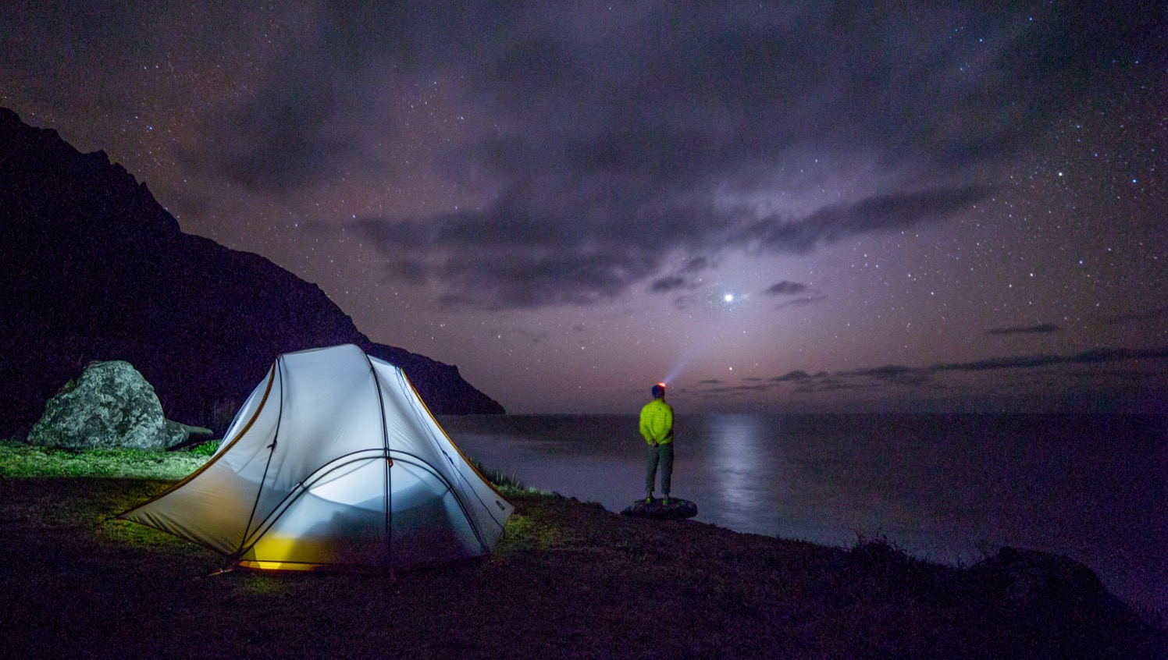
SOCIAL MEDIA HAS
NO LIMITS
- To Show and Promote Your
PRODUCTS / SERVICES
3. Be able to utilize social media as an empowering tool to promote a product or service.
* Be ready to change quickly! Instagram is the hot item now!!

Slide 13
WHAT ELSE IS NEEDED?
ACCESS TO OBTAIN seed funding and market links for the products and services.
UNLEASH the leadership potential we all have
ACHIEVE accountability to reach success
HIGHLIGHT in social media your unique product/service
4. Identify prospective markets based on skills/needs.

Slide 14
BUILD YOUR
NETWORK
HOW?
First: Reach out to your immediate family/friends.
They are not ready. They cannot give the support you need?
Second: Reach out to local organizations serving your specific needs. They can’t help?
Third: E-mail me - I’ll forward a list of data gathered to support your endeavor. (more than 30 different sources!)
Fourth: Be ready to work hard. Share your story.
Be ready to be surprised. Find a mentor!!

Slide 15
LATEST NEWS - find Rainbow Mosho and her art at:
* Upcoming books - Co-written and illustrated by Rainbow Mosho
* FB and IG = @Rainbow Mosho
* Internet: https://autismhappykingdom.com/
* YouTube: Autism The Happy Kingdom
* Thomais and her mom Yadira moved to TN from FL last August 2018 seeking academic progress and new opportunities
* They participated in the United Nations Autism Observance event promoting “Empowering Girls/Women with Autism”
Both were featured guests in the PBS Documentary “Autism Breakthrough to Hope”
Read their blog at Autism Happy Kingdom

