Slide 1



Navigating Adulthood on the Autism Spectrum
Practical Guidance for the Transition to Independent Living as an Autistic Adult
Presented by:
Laura S. Coleman
B. A. Psychology, Emory University
Marcus Autism Center, Atlanta, Georgia
Notes:
1
This presentation will cover the transition to adulthood for autistic young people, drawing from both lived experience and the academic literature covering the areas most significantly impacting autistic youth as they prepare to transition to adulthood, including career/education, independent living, healthcare, financial planning/management, social engagement/community, and relationships. Laura will provide practical advice as well as resources for both autistic individuals who are getting ready to transition to adulthood and their families.

Slide 2
Disclosures
I am employed by the Marcus Autism Center & Emory University as a Clinical Research Coordinator for the Simons Powering Autism Research Knowledge (SPARK) Study, part of the Simons Foundation Autism Research Initiative (SFARI).
I have received advisory funding from the Patient-Centered Outcomes Research Institute (PCORI), the Institute for Exceptional Care (IEC), Autism Speaks, and the Georgia College Transition Partnership (GCTP). I have also received funding as a consultant and film participant for a documentary film currently in production on the transition to adulthood for autistic young adults.
All opinions, thoughts, and experiences shared during this presentation are solely my own, and therefore should not be construed as necessarily reflecting those of my employer, academic institution, study sponsors, and affiliated partners.
Notes:
And just a heads up - I’m going to express quite a few opinions during this presentation (especially when it comes to social media), so however these opinions may be received, any credit or blame for this will be mine (and mine alone).

Slide 3
Content Advisory and Setting Expectations
This presentation will include some discussion of several mental health topics, including depression, anxiety, hoarding, hospitalization, and suicide.
I will indicate to the audience beforehand when I am approaching a more sensitive part of the presentation, in case any of you need to step out.
If you’re not in a headspace to be present for discussion of these topics, that is 100% OK.
  I will be happy to share my slides and any information related to the topics covered following the presentation.
  Your own mental health and well-being must always take first priority. There’s no need to apologize for taking care of you.
  So please know if you can’t stay for the presentation, I do not mind at all, and will be happy for you to follow up with me after.

Slide 4
Content Advisory and Setting Expectations
Given that we’re covering the topic of autistic adulthood, there is A LOT of ground to cover here—much more than can be covered in a single presentation.
Due to time constraints, I won’t be able to dive into nearly as much detail as these topics deserve. (*I will have a more content-heavy version of these slides available upon request.)
Thus, for those topics where there is already a lot of information out there that is readily available to access on your own, I will direct you to where I’ve found information and guidance on the topics that have been the most helpful to me.
What follows will therefore be less of a typical academic presentation, and instead much more focused on providing practical tips and advice, most especially for those who are themselves autistic adults and looking to embark on living independently for the very first time.
Notes:
Some topics will be just scratching the surface, but I will direct you on where to find the information that I’ve found most helpful. Others that are either less covered elsewhere or not included at all—especially social media, given its omnipresence in our modern lives—will be covered in more detail.

Slide 5
Itinerary of Topics Being Covered Today
Introduction - A brief overview and basic stats on autism in adulthood
Taking the journey – My own journey, what the journey should be vs. the reality, and a couple guidebook recommendations
Autistic adulting 101 – Tips and tricks for ASD independent living not typically found in books
  Additional guidance will be provided in the extended slides
Deep dive on social media – Using a prominent recent example as a case study
Closing thoughts – Reflections on autistic adulthood and overall take home message

Slide 6
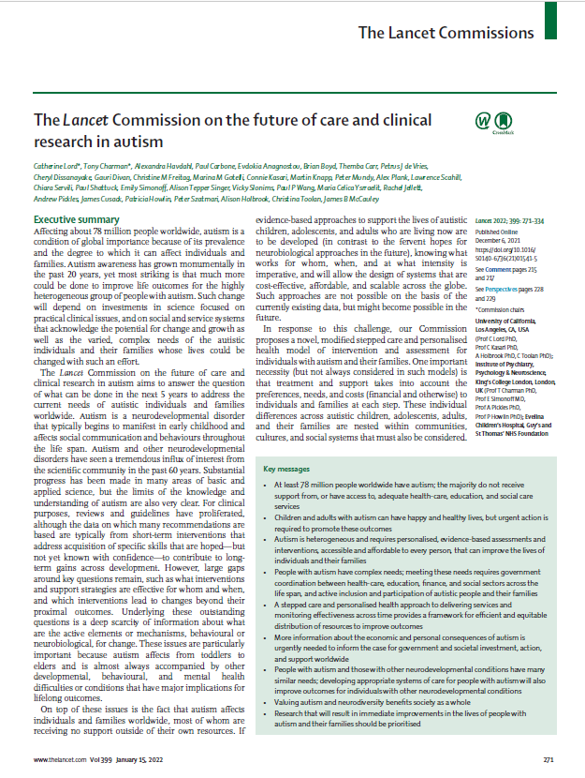
1.1 A brief introduction to autistic adulthood
According to the Lancet Commission (2021), the majority of persons with ASD are autistic adults (i.e. age 18 and older).
Despite being in the majority, substantially fewer services, supports, and research funds are allocated for autistic adults every year compared to children with ASD.
Lord et al. (2021). The Lancet Commission on the future of care and clinical research in autism.
Notes:
This loss of services following an individual aging into adulthood is commonly referred to as having reached “the cliff” in services and supports for autistic adults.

Slide 7
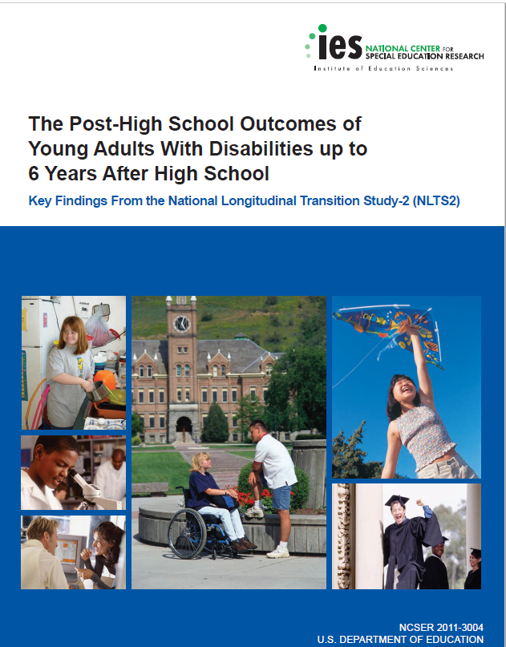
1.2 Autistic adulthood: By the numbers
Each year, between 70,000 – 110,000 autistic teens reach adulthood (i.e. age 18) and age out of school-based services.
  Early adulthood is understood as ages 18 through 34 (Furstenberg, Rumbaut, & Settersten 2005).
The National Longitudinal Transition Study-2 (NLTS-2; Newman et al., 2011) followed a group of secondary school students with disabilities over a ten year period of their early adult years.
  Disability was defined in this cohort as having received at least some Special Ed (SE) services during secondary school.
Newman et al. (2011)
Notes:
It’s worth noting that because of the definition they used to define students with disabilities (i.e., had to have received at least some SE services from 7th grade onward), there are a significant proportion of individuals with ASD who are excluded from this report – I was one of them, as I had never received SE services in school.
There has been increasing representation of young adults with ASD who seek postsecondary education. However, they still face substantial challenges once they have completed their college education, and they are also at a higher risk of not completing their degree.

Slide 8
1.2 Autistic adulthood: By the numbers
Compared to the general population, young adults with developmental disabilities have lower rates of pursuing postsecondary education and living independently.
  Young adults with ASD have even lower rates than this in both domains when considered separately from those with developmental disabilities (Shattuck et al., 2012).
Around 60% of young adults with disabilities have lived independently at some point since leaving high school.
However, when you compare individual disability types within this group, those with ASD were the least likely to have lived independently from their parents.
Newman et al. (2011)
Notes:
Although these numbers were pulled from a very rich, comprehensive, and painstakingly representative dataset of a national cohort, keep in mind that these numbers were published 12 years ago, and there have been substantial changes in housing affordability and accessibility across broader society in more recent years. National trends reflecting the ongoing housing crisis most likely have exacerbated these differences relative to what the stats were just ten years ago.

Slide 9
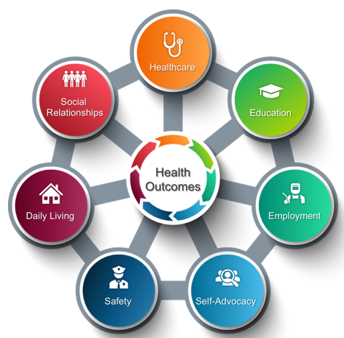
1.3 Key areas impacting outcomes of autistic youths transitioning to adulthood
Brasher and colleagues (2020) identified seven key areas impacting transition outcomes for autistic adults.
Found disparities in these key areas that disproportionately affected autistic young women and black autistic young adults.
Figure from Brasher et al. (2020)

Slide 10
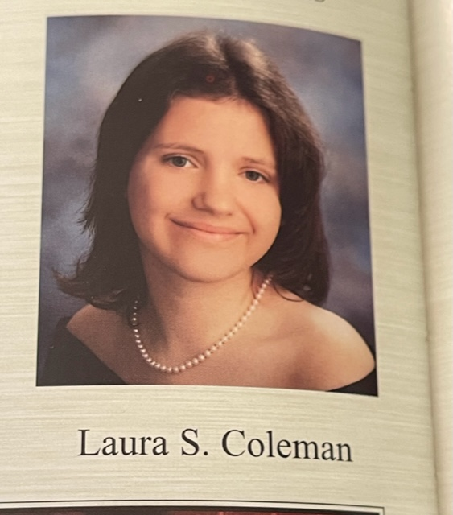

2. “The road less traveled”: When you have to take a nontraditional path through adulthood
This is me at 17 during my senior year of high school, right on the cusp of “officially” becoming an adult.
However, I most DEFINITELY took the long road in getting to where I am today.
The yearbook quote I chose for myself ended up being quite apt, not just throughout high school, but for my early adult years and college, too.

Slide 11
2.1 Brief summary of my first 10 years as an “adult”
*Trigger Warning*
The following summary of life events that took place during my first ten years of adulthood will include mention of severe depression, hospitalizations, suicide attempts, and loss from suicide.
If you’re not in the right headspace for this, now would be the time to step out.
Notes:
It is worth mentioning that I won’t be going into any detail for any of this.

Slide 12
Following high school graduation, the next ten years of my life included:
Just before senior year at Emory, my mom almost died after she made a near-fatal suicide attempt following us losing our home and moving back in with my dad. She spent over 2 weeks in a medical coma in the ICU.
Out of sheer hopelessness and despair, I made a dangerous attempt on my own life that initially resulted in expulsion, but was amended to being barred from campus and having to complete my degree remotely.
2 years at community college, earning my Associate’s degree.
Transferred to Emory University to complete my 4-year degree, started in Fall of 2006. Did not earn my degree until May 2016.
Chronic severe depression, multiple psychiatric hospitalizations, and several suicide attempts while an undergrad. Also learned I have ASD during this time.

Slide 13
Following my exile from Emory, I spent the next five years stagnating at my childhood home while living with my parents, including most of what remained of my twenties. During this time, I became resigned to accepting that the life I had hoped for myself would never come to be.
My grandmother passed away four years after I had moved back home, and my mother died by suicide barely a month after her, completely upending my world when I was just 27 years old.
The next year I spent grieving and recovering from the loss of my mom. After surviving that first year, I landed my first real job, and a few months after that, I finally moved out on my own. A year after I had moved out, I finally earned my degree from Emory, right before turning 30.

Slide 14
So yes, adulthood can be ROUGH. Even though you’re considered a “legal adult” according to your chronological age, it takes a lot more than that for you to actually feel like one.
So in an ideal world, what should it look like for a newly minted autistic 18 year old who is just starting out on their own for the first time?

Slide 15
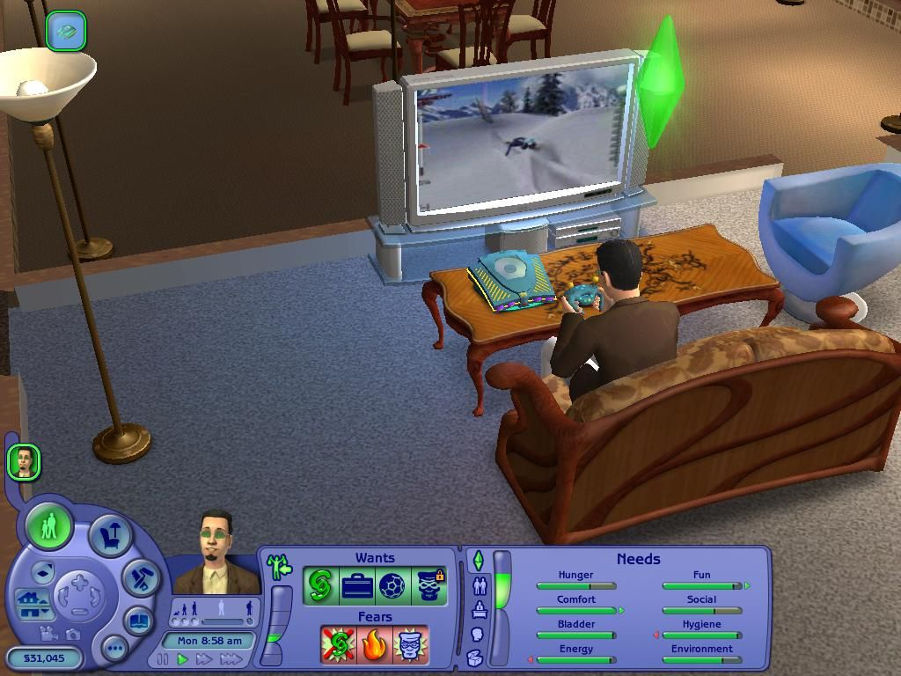



2.2 What The Sims 2 gets right about adulthood
Every new adult Sim starts out in the world of The Sims 2 with the following:
20,000 Simoleons
(= $20,000 USD)
Relatively easy access to an entry level position in the career field of your choice
An affordable starter home
  The one on the left would cost you only $14,000 in game (!!!)
  You’d still have $6,000 left over to furnish it with before you even got your first paycheck
Notes:
The thumbnail on the right is one of my favorite NPC characters from The Sims 2, the Social Bunny. If you’ve played the game yourself, you know what I’m talking about :)

Slide 16



Unfortunately, it is extremely unlikely that the U.S. Government will ever seriously consider taking policy recommendations from a strategic life simulation computer game from 2004.
Given that we have to live within the confines of reality, where should an autistic adult even begin when it comes to living independently?

Slide 17
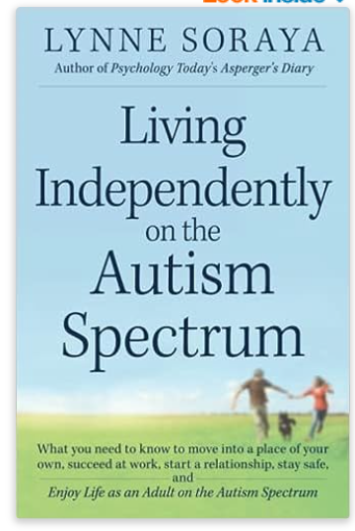
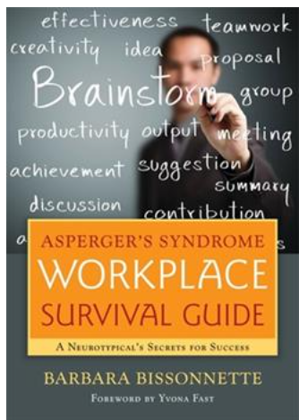
2.3 Every journey needs a guidebook (or two)
L. Soraya (2013)
B. Bissonnette (2013; 2010)
Notes:
These were my primary two guides when I first moved out on my own. Both are about a decade old now (I think publication date was 2013 for the Soraya book, and either 2012 or 2013 for the Workplace book), so they could definitely both use updated 2nd editions. But even reviewing them now, they still have a lot of good information and I’m still happy to recommend as an excellent place to start.

Slide 18
2.3 Living Independently on the Autism Spectrum
I found this book right when I was preparing to move out on my own for the first time, and it remains the best primer I’ve found on this topic to date.
Topics include:
  Learning how to advocate for yourself
  Managing meltdowns, emotions and sensory issues
  Communication
  Safety considerations
  Moving away from home & living with roommates
  Transportation
  Setting career goals, interviewing for jobs, and managing the workplace
  Navigating relationships (both making friends and dating)
Some things to bear in mind: 1. This book is 10 years old, so there are several sections that badly need updating (specifically relationships, dating, and social media safety), and 2. There are plenty of important topics it leaves out (e.g. paying taxes, financial planning, insurance, salary negotiation, etc.), but it is still an excellent place to start.
Notes:
Also worth noting that the author of this book is herself autistic. (It does only include binary genders, but bear in mind that nonbinary persons had much less visibility back in the early 2010s, so I do not believe the oversight was intentional.)

Slide 19
2.3 Asperger’s Syndrome Workplace Survival Guide
This is the best book I’ve found so far that covers how to survive and thrive in the workplace while on the autism spectrum.
Topics include:
  Communication
  Making a good impression and getting along
  People skills and office politics
  Executive functioning and how to adapt at work
  Emotion regulation and managing negative emotions
  Career planning and development
  When and how to disclose and/or request accommodations
  Also includes a guide for employers to better understand ASD employees
The book is written from a neurotypical (NT) perspective, but keep in mind that most workplaces are also built by and for NT people. Most critically, this book helps demystify the seemingly nonsensical expectations and confusing culture typical of an NT-dominant workplace.
Notes:
“Getting along w/ others” = social cohesion in the workplace

Slide 20
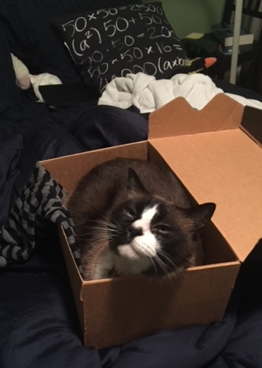
3. Autistic Adulting 101: I’m on my own, now what?
When I first moved out, I had next to no furniture, kept all my clothes in boxes and just slept on a mattress on the bedroom floor of my new duplex apartment.
Even so, I cannot put into words just how happy I was to have finally made it into a place that was all my own. I might not have had much, but it was enough.
However, once I became independent, there was A LOT of work to be done for me to be able to STAY independent.
*And as you can see in the pic above, my kitty Claudette was very happy for us to finally be living on our own, too. 💙
Notes:
Along and along, as you continue pulling in a paycheck and putting some money away, you’ll eventually find that you have enough to start filling your living space with what you need—gradually, over time.

Slide 21



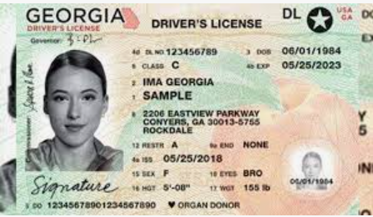
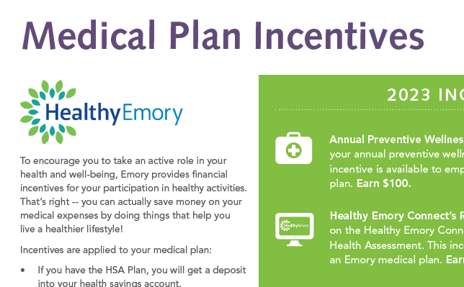





3.1 Learning how to “adult” on the autism spectrum…
(yes there’s A LOT 😲)

Slide 22
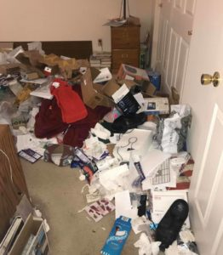
…By first learning how NOT to “adult” while ASD :/
This is how my dad, an Aspie of the boomer generation, generally keeps his important papers and files.
Believe it or not, a picture of the real thing would actually look even worse than this.
On most occasions when he’s searching for something, it takes 1-2 hours for him to find what he needs. In rare cases, it can take as long as a day or more.
Notes:
It’s hard to do other basic adulting things when this is what your home environment looks like. It’s a big part of the reason why I stagnated for 5 years living in a home like this – it’s so depressing/horrifying just being there, it’s practically impossible to get anything meaningful done. (Not to mention immensely isolating and lonely, too, as you’re equally horrified by the thought of ever inviting anyone to visit you at home.)

Slide 23
When I was preparing to move out on my own for the first time and finally leave this type of home environment, I wanted to avoid living this way at all costs.
But there’s also A LOT to manage when it comes to living independently, so I had to learn to harness certain behavioral tendencies that already came naturally to me by putting these seemingly pointless habits to good use (while keeping the less useful ones in check.)

Slide 24


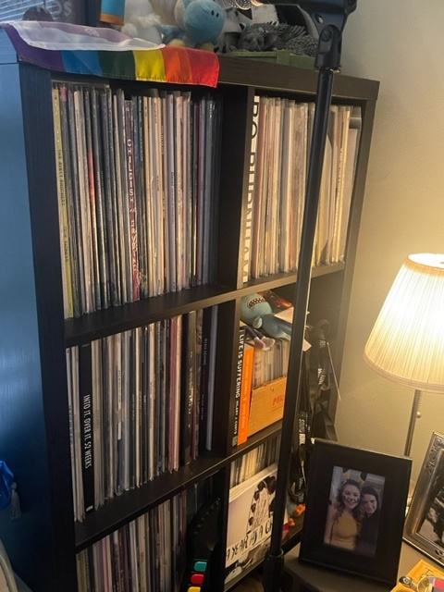
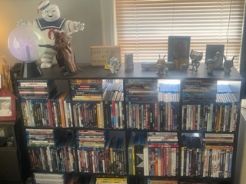
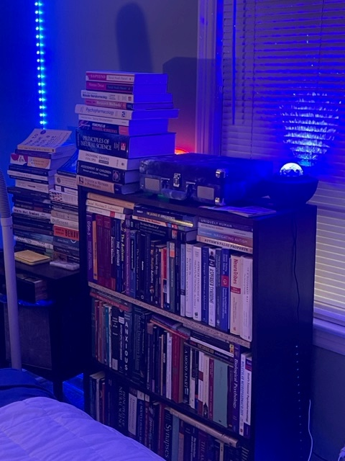
3.2 Example of learning how to harness a pre-existing inclination for a useful purpose
“Strong in this one, this urge to collect…”

Slide 25
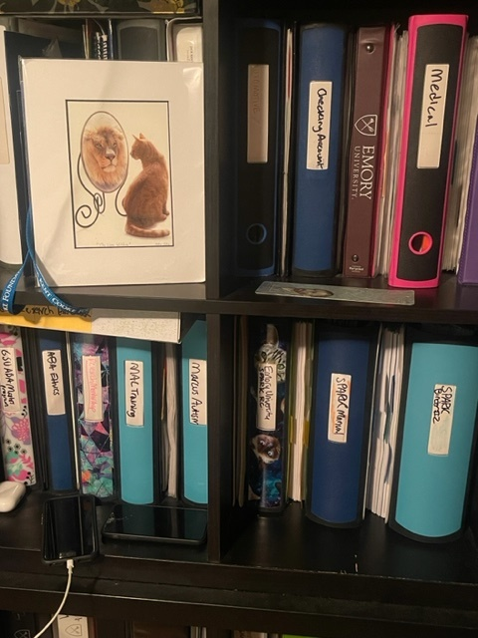
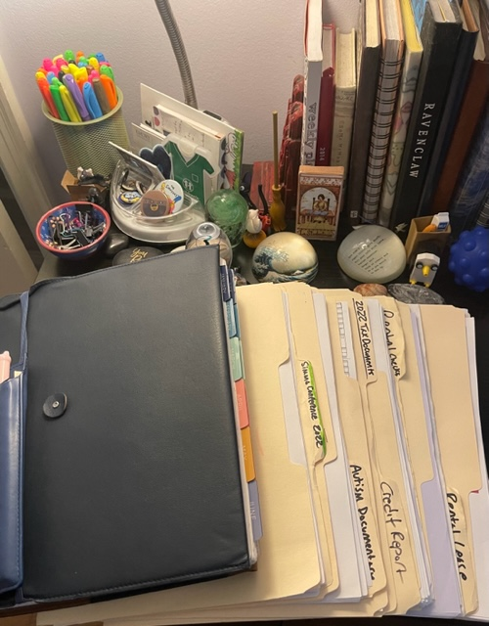
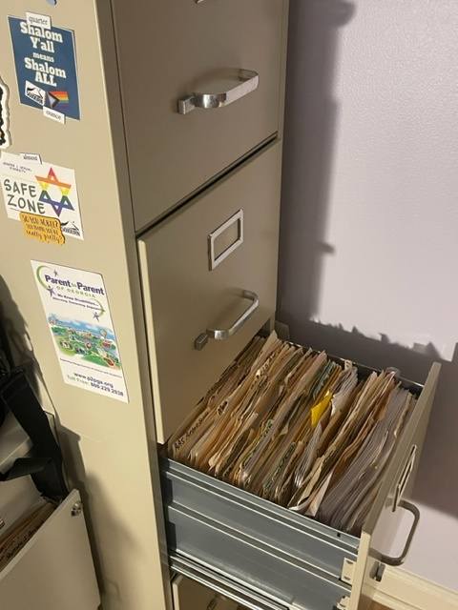
“…Harness this urge, we must.”
I learned how to utilize my inherent love of collecting and organizing by applying this interest to create a system for managing and keeping track of my most important documents and files.

Slide 26
Get creative - Adapt it to work for you!
“Just buy an office size filing cabinet and put it in your spare bedroom, and then lean into your fondness for meticulously organizing and categorizing EVERYTHING” is obviously NOT going to work for everyone with ASD.
But you can still work with this idea as a more general guiding principle while figuring out how to manage adult responsibilities.
For example - If you naturally like to organize and impose order on your environment, use this by building your own system onto what already comes natural to you.

Slide 27
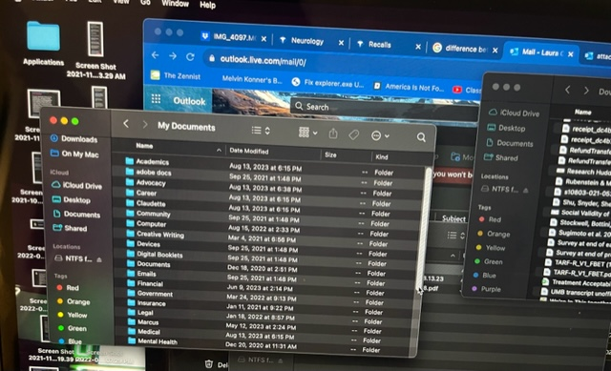
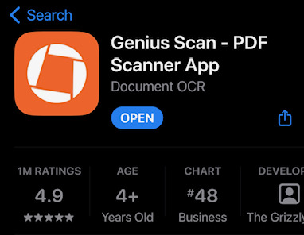
Going digital is also a perfectly good way of storing and managing your important files.
All the documents I’ve kept in my physical filing cabinets could also technically be scanned and stored on a computer instead. You can organize your own files in a similar way, too.
Just be sure to have AT LEAST TWO forms of backup for your documents. For myself, I use both cloud storage and an external hard drive.
This free app is AMAZINGLY easy for scanning any document!
Notes:
I’ve only used Genius Scan on my iPhone (12 pro max), though, so I can’t speak to how good it is on other devices. But it comes in handy quite often in my own day to day life, so I’m happy to give it a shout out here.

Slide 28

3.3 Quick tips: Autistic adulting and finances
Setting up automatic bill pay for utilities makes a HUGE difference in time saved; just make sure you keep enough above the minimum in your account to cover it.
If you qualify for Turbo Tax to file your taxes 100% free of charge, then it is MUCH easier for completing your taxes; however, most likely you will not qualify. AVOID using a tax filing service UNLESS you can use it for free – It is possible to file your taxes on your own.
When searching for your first apartment, location is key. A critical consideration is commute time/travel distance from your place of employment. It may be worth a slightly higher rent to cut down on commute costs (both time and money).
Seemingly small expenses add up FAST. This applies for streaming subscriptions, food delivery services, ride shares, and so much more. Depending on your situation, you may not need to always set out a budget, but ALWAYS be mindful of how much you’re spending.
Online banking apps are a GODSEND 🙌🏻
Compare your different options and choose among them carefully. FOMO can be weaponized against you to make you take risks you wouldn’t otherwise take. If you can’t decide, ask someone you trust to help you.
It is 100% OK to ask someone you trust who has more experience with something for help when you need it.
Notes:
*Update recommendation – There exists a TurboTax alternative called TaxAct (thank you to one of the audience members who emailed this pro tip!) See appendix 3 slides at the end for side by side comparison. This most recent year was the first time I got seriously burned using tax prep software (e.g., in my case it was Turbo Tax.) The previous two years they did take a small cut of my return (which they had filed for free in previous years, but whatever) - BUT this year, what they charged me for filing my taxes amounted to about 40% of my entire tax refund. So when tax season comes around next year, my new year’s resolution is to learn how to file my taxes on my own without using predatory tax prep software that extorts my tax refund from me just for me to be able to file my taxes. - Also the reason I HIGHLY recommend utility bill auto-pay is because there can be MASSIVE consequences if I forget to pay a utility bill – e.g., I could end up not just with fees, but having essential services (like cell phone service/wifi, electricity, car payment, etc.) completely cut off. So for these bills, I always keep them on auto-pay, and also lock in a guaranteed rate when it’s available (e.g. for Natural Gas.) My credit card I don’t have on auto-pay, but I still have a reminder of the due date on my phone, so I can review it first to make sure it looks reasonable (i.e., no fraud) before submitting the payment.

Slide 29

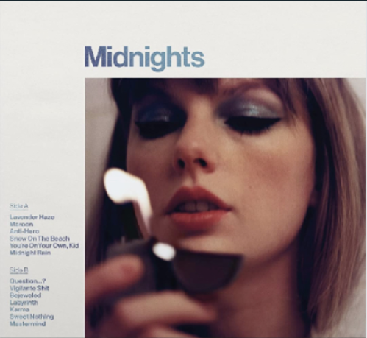
3.3 More quick tips: Autistic adulting and advocacy
Build your confidence by doing what you already love.
What does this look like?
For me, I absolutely LOVE Taylor Swift’s music, and I have been singing her songs in the car over and over for nearly ten years now (i.e., what I’ve dubbed “Taylor Therapy”). This practice has gone a long way in improving my confidence when I speak.
Illustrative example of
“TSwift Therapy” -
i.e., me ceaselessly singing Taylor Swift songs to myself in
the car:
Regularly practicing your speech/communication helps it flow more naturally. Use whatever medium most connects with you.
“You’re On Your Own, Kid”
By Taylor Swift
“…There were pages turned, with the bridges burned -
Everything you lose is a step you take.
So make the friendship bracelets,
Take the moment and taste it,
You’ve got no reason to be afraid.
You’re on your own, kid…
Yeah you can face this…
You’re on your own, kid, you always have been.”
For situations that may cause anxiety (e.g., calling for medical appt, customer support, etc.), write out a script in advance. Have it in front of you if you’re on the phone. You can also disclose having ASD.
Notes:
Lyrics for this song are actually quite apropos for this topic. Also for the last box – It’s ok to be on the phone with a customer service rep or medical professional and tell them, “Hey, I am autistic so it may be difficult for me to communicate some of the time during this call.” This is especially a good idea if you’re currently in a meltdown (e.g., I’ve been in meltdown mode on the phone with my health insurance company before precisely BECAUSE of something they had screwed up and caused me distress due to an unanticipated bill. Usually the rep on the other line is understanding and tends to be much more helpful than they would’ve been otherwise, had I not disclosed my disability to them.)

Slide 30
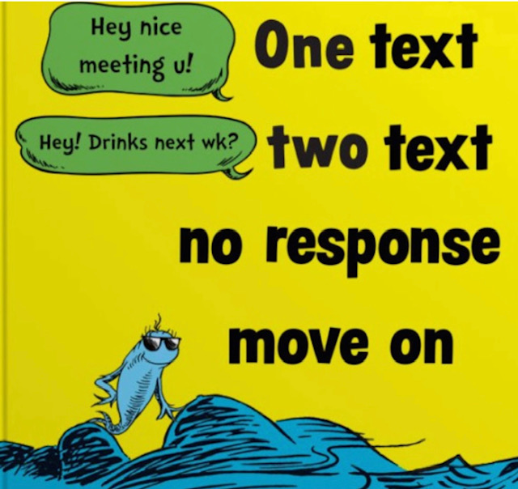
3.3 Last quick tips: Autistic adulting and being social
Don’t overinvest in relationships where they don’t give very much back relative to what you’ve put in. It doesn’t mean you’re “not good enough”; all it means is that with this specific person, you’re not likely to be compatible.
It tends to be easier to make connections that last with those whom you already share a community with.
Your friends are not your therapist. It’s ok to disclose personal details once you’ve become close, and it’s also ok to occasionally vent. But be sure to not become overly emotionally burdensome in what you share, and be mindful to listen to your friends’ disclosures and support them, too.
Be gracious and forgiving when your friends and dating partners need to cancel plans and/or end up letting you down. The more people you meet and befriend, the more likely it is that you will end up doing this to someone yourself at some point.
You should never feel ashamed of spending time alone. Solitude is a gift. Even with having a considerable network of friends, I still treasure my alone time.
Notes:
*Note that the Dr. Seuss graphic is DEFINITELY NOT MINE. I’d cite the original creator, if only I knew who this was :/

Slide 31
3.4 Helpful mindsets to carry into adulthood
Resist seeing things solely through the lens of an either/or dichotomy. Usually there’s much more to it than that.
Remember that what you see in front of you is just the finished product. You never see all it took for that person’s story or social media post to exist.
    For this same reason, take care to never romanticize mental illness and trauma. It’s never something anyone should want for themselves.
See the value in everyone around you. There is something to appreciate about every person you may encounter.
Embrace your strengths. Acknowledge your limitations and learn to work within them, while making an effort to challenge yourself and expand the boundaries of the things that you currently find limiting.
Maintain a healthy skepticism. Don’t necessarily default to always assuming the worst in people, but still take caution whenever someone puts any suggestion or request on you that would entail a significant cost to you, whether it be financial or otherwise.

Slide 32
3.4 More helpful mindsets for adulthood
Live as honestly and genuinely as you can. It’s a lot more difficult to trip yourself up when what you say and what you believe actually reflect your own sense of reality.
It really is hard to put on a smile and have confidence when your brain has been trained for your entire life to expect people to reject you. This isn’t a way of thinking that will ever just go away overnight, but it can be gradually overcome.
I had never realized that by fearing rejection and avoiding it at all costs, I inadvertently would end up rejecting others I had never intended to. I don’t think I’m the only one who does this.
Remember that the fear of failure, just like the fear of rejection, can both limit and inhibit you on its own accord, making it that much more difficult to initiate what you’re trying to do. No one is perfect, and there will be times that you will fail and do the wrong thing. It’s ok – we all do. Accepting this will help you overcome the inertia that would otherwise prevent you from starting.
Accept that you’re always going to be a work in progress, that there is no “perfect” version of yourself for you to reach for. Accepting yourself as you are, and accepting that who you are is enough, is key to maintaining mental stability.

Slide 33
One last mindset…
(*and arguably the most important one)
There is no “right way” to adulting on the autism spectrum. Just as every autistic person is different and distinct from one another, the same is true for each autistic person’s path through adulthood, too.

Slide 34
4.1 Deeper Dive: Navigating Social Media
Engaging on social media as an adult requires additional considerations that you’re unlikely to be as mindful of when you’re a teen.
Some general guidelines are as follows:
Always be cautious when posting – Don’t forget that what you post to the internet is public for all to see, and it can be used against you by others when they are making decisions that could have a big impact on you.
  For example, prospective employers can (and actually DO) cull through your past social media posts, to get a sense of who you are as a person and help inform their decision of whether or not to offer you a job.

Slide 35
Understand that your presence on social media can be much more easily weaponized and used against you in a way that your normal day-to-day life cannot.
The internet does not forget – Even if you think you have completely scrubbed a post or sensitive information from ever again seeing the light of day, bear in mind that if someone is highly motivated and has the technical skill to do so, they may still be able to track this information down and bring it back to public awareness.
I’m not saying any of this to trigger your anxiety – There are ways to deal with undesirable content either posted by you or about you being on the internet, especially when you had posted it back when you were just a kid.
Whatever you decide to post, always be sure to post with care.

Slide 36



4.2 A Social Media Case Study of How to Handle Trolls and Other Unpleasant People on the Internet
I’d like to take us on a slight detour using an example to illustrate the importance of the need to be mindful of what you say and do on social media (*which can also be expanded to IRL conflicts, too).
Let’s go back to the end of 2022, when an unexpected feud erupted on social media between public figures Andrew Tate and Greta Thunberg…

Slide 37



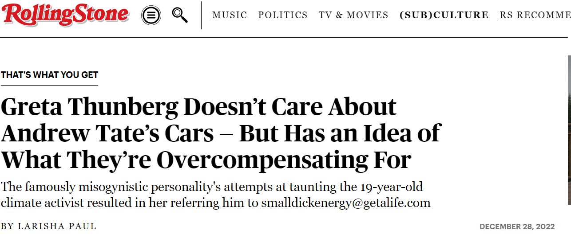
Andrew Tate
Greta Thunberg

Slide 38

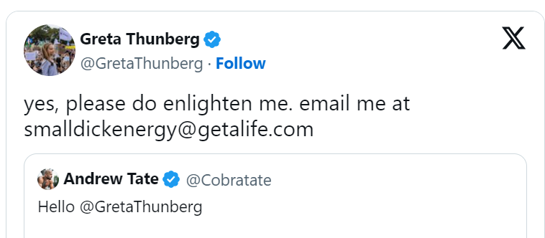

Slide 39


Nothing more satisfying than putting a troll in his place, right?
And yet…
…Take a moment to stop and consider the following facts, by thinking through the implications of her retort (see next slide)
(*and no, by no means am I implying that Andrew Tate is actually a good person, but there’s more to consider in this example.)

Slide 40
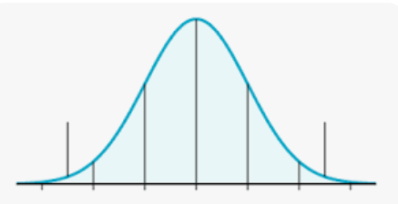
Theoretical normal distribution of the “physical endowment” of the total global population of men
When you consider all men collectively, a mind-boggling figure that includes billions of people across the globe…

Slide 41
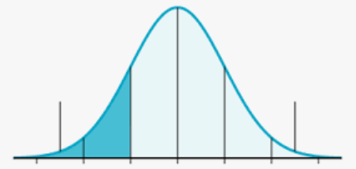
Theoretical normal distribution of the “physical endowment” of the total global population of men.
*Note - Shaded region indicates all men who are at least one or more standard deviation(s) below the mean (i.e., smaller than the “average male endowment”).
**Not to annoy you with math, but the global population of men is approximately 3.97 billion people, so the shaded region would include 635 million people.
…you make a startling realization.

Slide 42
…You realize that those men who are smaller than average in this specific physical attribute (i.e., those who would be classified as “less endowed” than average) comprise an incredibly diverse group of people, a large number of whom are undoubtedly great, amazing human beings, and DO NOT deserve to be indirectly shamed for possessing a specific physical attribute that they themselves have no control over.
This can be said of practically any physical characteristic a person may have.
It has nothing to do with whether or not someone is a decent human being.

Slide 43
And even if Greta had been on to something when it came to Andrew’s ridiculous posturing possibly being his way of compensating for his assumed “shortcomings,” it might have been a good idea for her to have asked herself,
“Why would he feel the need to do that?”
Were she to remember, “Oh that’s right - our society tends to shame men who are less physically endowed,” she might have asked herself,
“Wait - why am I striking back with an insult that only serves to perpetuate this ridiculous standard?”

Slide 44
What lessons can we learn from this?
Someone’s physical attributes are NOT a reliable indicator of who they are as a person.
An individual’s words, behaviors, and actions DO tend to be a more accurate reflection of who that person is and what they believe, at least during that specific point of time in their lives.
Although putting down an adversary on social media by taking cheap shots at their physical insecurities during a public feud can be momentarily satisfying, going this route ultimately undermines your argument by making you appear inconsistent in upholding your own professed values.

Slide 45

Are there better options for how to handle yourself when you’re being targeted by a troll?
Although I fully admit that as a 37 year old elder millennial, I am ANCIENT by internet standards, I do have a few suggestions…

Slide 46
Some suggestions…
Typically, trolls thrive on attention. Engaging with them and exchanging insults will never cause them to back down nor change their minds; instead, doing this will only embolden them to intensify their attacks against you.
Unless they are doxing you or making an immediate threat against you, usually your best option is to ignore them.
Remember that you are under no obligation to engage in social media spaces where you are vulnerable to such attacks.
Personally speaking, I am very happy to no longer engage on any social media platform where my personal identity is attached to it. I know that’s not an option for everyone, but it has done wonders for me since I quit doing it myself.

Slide 47
And if not engaging is NOT an option…
You are well within your rights to call out someone for their behavior, especially when they express a belief or opinion that is demonstrably hateful and/or damaging to other people.
You are also within your rights to bring attention to the harmful effects that their words or actions have on yourself, on other people, on other species, on society, and/or on the planet as a whole.
You are free to say they’re misguided, misinformed, or even in outright denial of reality, or you can call out inconsistencies in their argument.
But always bear in mind that it is never helpful to criticize someone on account of their appearance, nor is it ok to make fun of any other physical or mental trait that they themselves have no control over.
The main reason for this is that there are plenty of other people who may share the same trait you’re openly criticizing your antagonist for having. They have nothing to do with the antagonist’s bad behavior, so it is unfair to even indirectly bring them into it.
Notes:
But also keep in mind the potentially negative effect on your own mental health/well-being that responding to negative comments/interactions may have on you, should you decide to respond to an online antagonist who is targeting you or engaging in offensive behavior. Generally speaking, negative interactions do have an adverse effect on your mood, so make sure you’re in a good headspace yourself before you consider taking something like this on in an online forum. There certainly is wisdom to the phrase, pick your battles.

Slide 48
And since that previous slide was a wall of text, here’s the TL;DR version:
Whenever you find yourself in conflict with someone, whether online or in person, try to target the person’s harmful ideas, behaviors, or actions, while trying to avoid attacking the person themselves.
Example:
“Saying [insert bad thing] is really harmful, here’s why…”
INSTEAD of:
“You are just a horrible, sh***y [insert vulgar insult] and [insert another insult] for saying [insert bad thing]…”
Notes:
But also know that we all do this, myself included. However, being more aware of when you’re doing this, and quickly either owning up to it or stopping doing this immediately, does make a world of difference. Thus, it is a pretty good standard to try to hold yourself to.

Slide 49
And for anyone who may despair at the thought of finally putting down Twitter (or rather, ugh, “X”…)
Twitter/”X” is, and has always been, an absolute dumpster fire.
No less than 98% of everything that has ever been said on the platform is at least one or more of the following: dull, uninspired, meaningless, nonsensical, stupid, offensive, inflammatory, entirely forgettable, and/or just plain wrong.
The remaining 2% of tweets that have at least some measure of value are not enough to justify continuing to subject yourself to the vast majority of the platform’s content, which can tidily be summed up as total garbage and a complete waste of your time.
If you’re looking for good writing, that is what books and The New Yorker are for. Apps like Substack and Medium also exist, too.
Notes:
Obviously my personal opinion shows here, but I can at least affirm that I’ve found my own day-to-day life to be much more pleasant without paying any attention to what random people decide to shout out into the void of the internet on “X”.

Slide 50
4.3 Meditations on giving up the chase for likes and validation through social media (*and more generally, too)
When I realized that I’m not less than anyone else—not on social media, nor in real life—this was the first time I truly felt free from the shackles of my deeply rooted sense of inferiority.
When I realized that I’m also not better than anyone else, this was the first time I truly felt released from the relentless pressure to excel and succeed.
These two complementary realizations were what finally made it possible for me to feel ok with
being me.

Slide 51

5. Closing reflections on autistic adulthood
As you prepare to travel the road through adulthood as an autistic person, if there is only one overall message that you take with you after our time here today, I hope that it would be what follows…

Slide 52
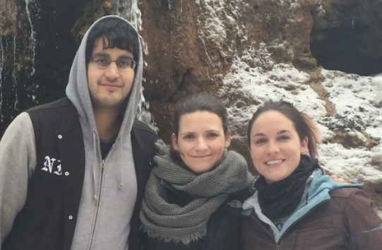
(1.) Everyone who may accompany us along the journey to becoming who we are meant to be—family, friends, loved ones, every person we meet—all of them are a gift, for us to enjoy their presence for as long as they’re with us.

Slide 53
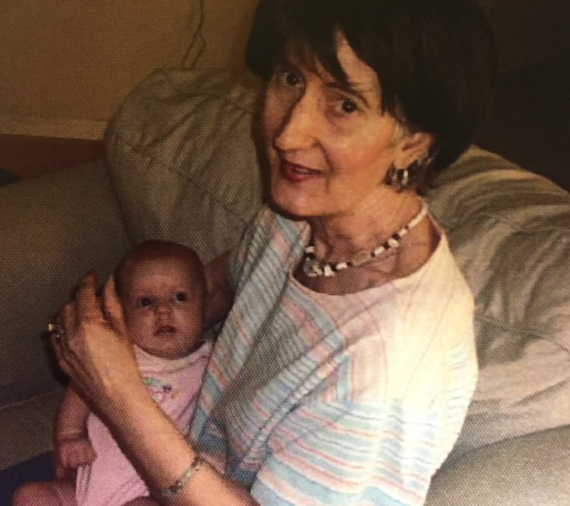
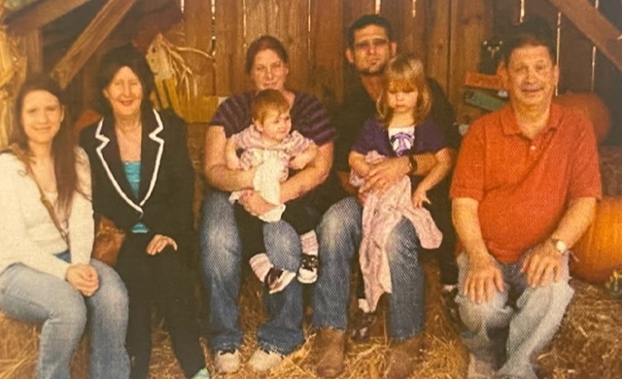
(2.) But part of being an adult—any adult—is learning to accept that none of those you know and love are guaranteed to always be in
your life.

Slide 54
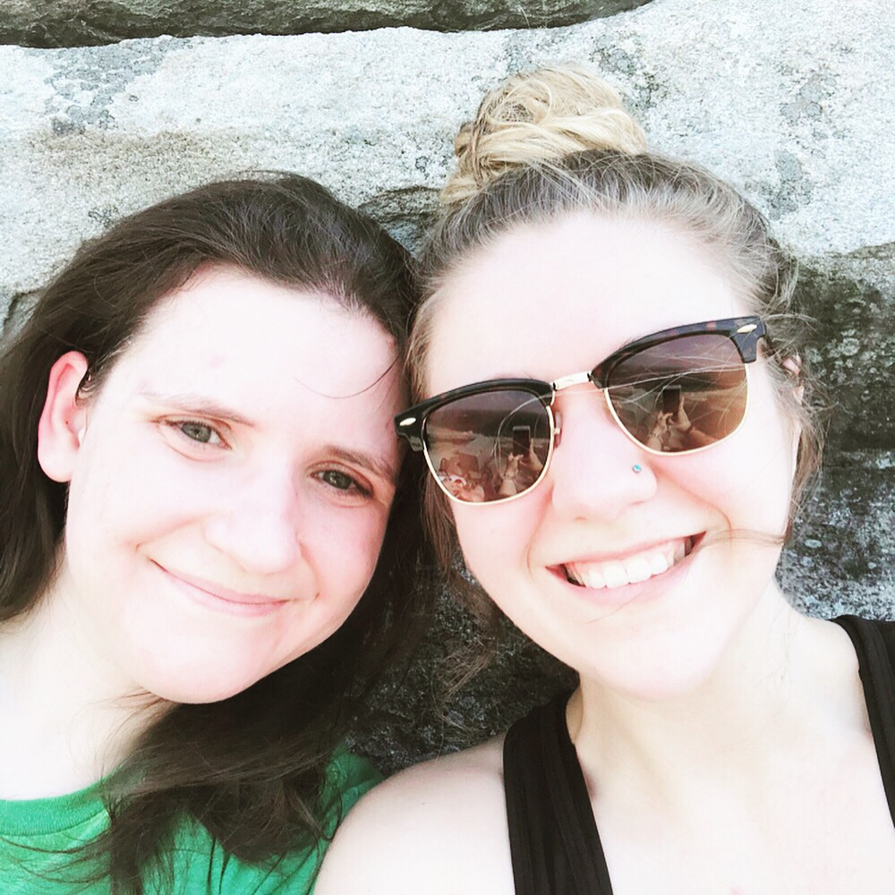
(3.) So be sure to appreciate every moment you have to share with those you love, because you do not know how much time you have to be able to spend those moments together.
However, there is one thing that you CAN always be sure of…

Slide 55
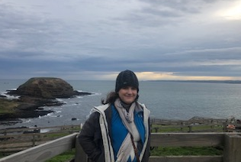
(4.) The one person you will always have, from the moment you took your first breath, to the moment you have breathed your very last, is you.
(5.) So do your very best to make every moment of your adult years count, so that you can become the “you” that you want to be.

Slide 56
Acknowledgements
This presentation would not have been possible were it not for the work of Dr. Susan Brasher under her PCORI Grant, Nurturing Engagement in Stakeholders on Transitioning to Adulthood in ASD (NEST).
Several of the ideas and stories shared in this presentation have also been influenced by the work of filmmakers Ben Sharif and Karen Shapiro, who were inspired by Ben's younger brother, David, to provide a platform for autistic people to share their stories as they navigate their journey through adulthood on the autism spectrum.
I also would like to thank several remarkable faculty from my undergraduate years at Emory University who were absolutely critical in not letting me fall through the cracks, specifically Dr. Melvin Konner, Dr. Nancy Bliwise, Dr. Darryl Neill, and Dean Joanne Brzinski.

Slide 57
Acknowledgements
My friends and colleagues at both the Marcus Autism Center and on the SPARK Study with the Simons Foundation have afforded me with the opportunities that provide for my livelihood, making it possible for me to continue living on my own and building a life for myself.
Most of all, I must make mention of my mom, Marcia Gail Coleman, who is the biggest reason why I have successfully transitioned into being the autistic adult I am today.
Had it not been for the tireless support, dedication, and guidance of all of these individuals, as well as so many others who number far too many for me to mention individually, I assure you that I would not be here speaking before you today.
Finally, Thank You for being here to listen.

Slide 58
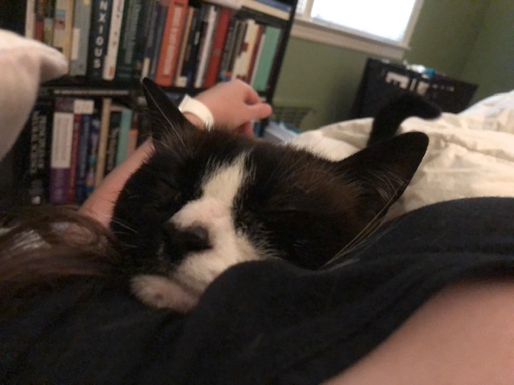
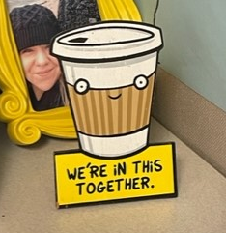

THANK YOU
Questions?
*If there’s not enough time for me to get to your question –
please reach out to me to ask by either approaching me after the talk or getting in touch using my contact info below.
Laura’s Contact Info
Email: Laura.Suzanna.Coleman@emory.edu | Phone: 404-785-9467

Slide 59
Appendix 1: Book recommendations
Books I have myself read and highly recommend to any autistic adult:
Living Independently on the Autism Spectrum, Lynne Soraya, 2013.
Asperger’s Syndrome Workplace Survival Guide, Barbara Bissonnette, 2010, 2013.
Be Different, John Elder Robison, 2011.
Uniquely Human, Barry Prizant, 2015, 2022.
Books I have on my bookshelf and intend to read, but haven’t had a chance to finish reading these just yet (but could still be worth your time):
The Guide to Good Mental Health on the Autism Spectrum, Purkis, Goodall, & Nugent, 2016.
Asperger’s On the Job, Rudy Simone, 2010.
How to Find Work that Works for People with Asperger Syndrome, Gail Hawkins, 2004.
Books I’m interested in, but haven’t gotten yet:
The Autism Job Club, Michael Bernick & Richard Holden, 2018.
Neurodiversity at Work, Theo Smith & Amanda Kirby, 2021.

Slide 60
Appendix 2: Bonus Quick tips that didn’t fit on the slides
You can strategically take advantage of 30-day free trials by starting them at the most opportune time*, and then setting a reminder notification to cancel the day before the date when the subscription price kicks in.
When you’re furnishing your first apartment, I highly recommend seeing what furniture you can find from listings on apps like Nextdoor or Facebook Marketplace instead of buying new. Usually you can find much better quality pieces than Ikea or Wayfair, but still at a good price.
If you consider investing on investment platforms like Robin Hood or in cryptocurrencies, be sure to always follow the “golden rule”: Never invest more than you are comfortable with losing. Realistically speaking, there is no shortcut to financial independence, especially when it’s solely through retail trading. If an influencer/”finfluencer” claims that they themselves have done this, they are either lying or not telling you the whole story.
Longer-term investments tend to be better methods of building wealth and saving for retirement than trading individual stocks (especially “meme stock” fads). Investing in an index fund through an employer-sponsored account tends to perform better than actively managed investment accounts. If you’re able, consider diversifying your investments (e.g. combo of stocks, bonds, etc.)
Be mindful to put healthy limits with how much time you spend online or on your phone. It’s really easy for it to start negatively impacting you before you even realize it. Moderation is key.
Notes:
*By “most opportune time”, here’s an example – If I know I have a deadline coming up on a presentation or paper I’m trying to write, and I see that I have available a 30 day free trial for a food delivery premium service (i.e., that reduces or eliminates fees), then I’ll start the trial for the month leading up to that deadline, so I won’t have to spend as much time on food shopping and can used the time saved for the project I’m working on instead.

Slide 61
Appendix 2: A few more bonus quick tips
It’s great to love collecting your favorite type of collectibles (e.g. records, books, graphic novels, video games, figurines, etc.), but always be mindful of how much you spend on these. It’s far too easy for this type of cost to spiral away from you (believe me – been there, done that.) If you can put a healthy limit on how much money you spend on your favorite hobbies (e.g., just buying one vinyl record per month, or allow yourself two if you’ve achieved a goal you’ve been working towards), it will allow you to continue doing what you love without potentially putting yourself in a dire financial position.
If you have as much trouble starting tasks as I do, use behavior strategies to work through the inertia/internal resistance to start. For example – I have an email I need to write, but my brain feels exhausted and would rather watch a 10 minute YouTube video instead. Solution – Impose on myself a “first, then” rule, where I only allow myself to watch the video after I wrote the email. Another option is to break up a bigger task into smaller tasks, and to the easiest of the smaller tasks first before attempting the harder parts.
Got autistic adulting quick tips of your own?
Feel free to copy the quick tips slides and add to them as you wish!

Slide 62
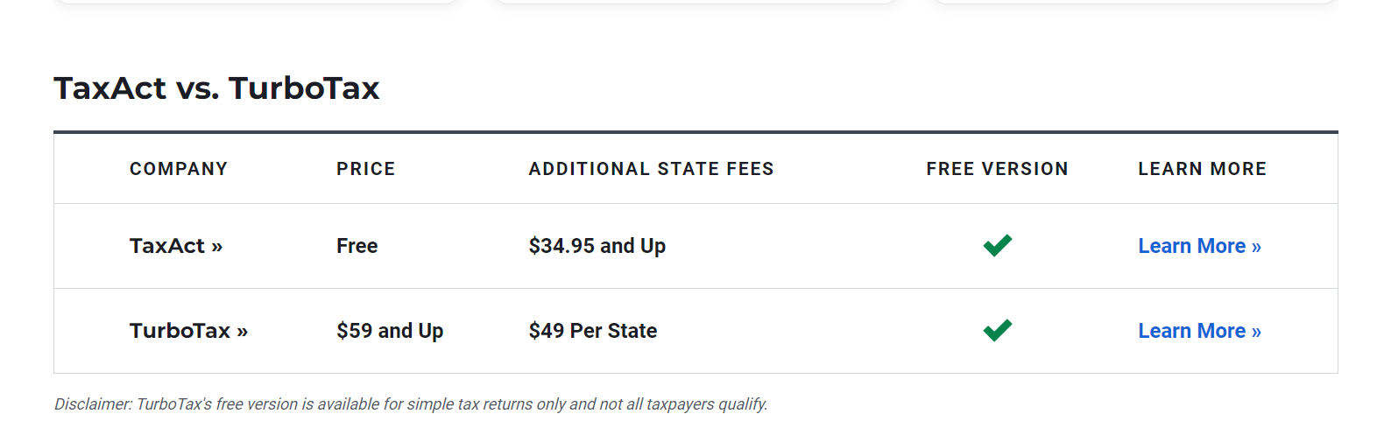
Appendix 3: Additional Tax Tips
Chart from U.S. News & Report, at https://www.usnews.com/360-reviews/technology/tax-software/taxact-vs-turbotax
*For the tiny print they don’t want you to notice, it says: “Disclaimer: TurboTax’s free version is available for simple tax returns only, and not all taxpayers qualify” (underline added for emphasis.)
For this autistic taxpayer who still makes a relatively modest income but definitely did not qualify for free filing with TurboTax, the “fees” that I was on the hook for amounted to slightly more than a third of my tax refund. (Just calculated it and can confirm.)
Keep in mind that if you get a significant promotion or pay raise that puts you into a higher tax bracket, you will most likely be taxed at a higher rate (which = smaller tax refund, all else being equal).

Slide 63

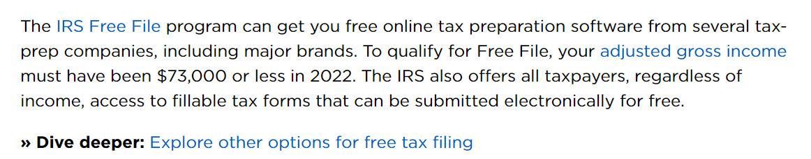
Appendix 3: Additional Tax Tips (cont.)
A good place to start, especially if you plan to be responsible for filing your own taxes for the very first time, is this handy guide from NerdWallet:
https://www.nerdwallet.com/article/taxes/tax-filing#:~:text=There%20are%20three%20main%20ways,the%20work%20of%20tax%20filing.
Notes:
Considering that your tax bill is due on the deadline date in April, regardless of whether or not you need an extension for filing - This is why I personally recommend that when you are hired for a new job and are filling out your new hire paperwork, always elect to have your taxes withheld from your paycheck. It’s much easier (and less mentally taxing) to have taxes withheld from the get-go and potentially get a refund after you file, instead of being on the hook for your tax bill once April comes around.

