Slide 1
Hamilton County Department of Education
Assistive Technology Department 2017-2018

Slide 2
Assistive Technology Definition
IDEA defines an 'assistive technology device' as...
any item, piece of equipment, or product system, whether acquired commercially off the shelf, modified, or customized, that is used to increase, maintain, or improve functional capabilities of a child with a disability. (20 U.S.C. 1401(1))
IDEA defines an 'assistive technology service' as...
any service that directly assists a child with a disability in the selection, acquisition, or use of an assistive technology device. Such term includes -
(A) the evaluation...
(B) purchasing, leasing, or otherwise providing for the acquisition of assistive technology devices...
(C) selecting, designing, fitting, customizing, adapting, applying, maintaining, repairing, or replacing...
(D) coordinating and using other therapies, interventions, or services with assistive technology devices...
(D) training or technical assistance for such child, or ...the family of such child...
(F) training or technical assistance for professionals... (20 U.S.C. 1401(2))
IDEA 2004, Wrightslaw: Special Education Law, 2nd Edition, p. 49.
- See more at: http://www.wrightslaw.com/info/atech.index.htm#sthash.pFMhaVP6.dpuf

Slide 3
Who are we?
Our team is comprised of speech and language therapists, exceptional education teachers, and a technology coordinator who work in conjunction with vision specialists, occupational therapists, and physical therapists and exceptional education teachers.

Slide 4
What do we do?
Provide exceptional education program support for system wide classes
Provide exceptional education program support for direct service providers
Provide augmentative communication strategies for children with language disorders
Provide suggestions for educational environmental access for children with mobility impairments
Provide assistive technology consultations/assessments for children who are referred by IEP team decisions

Slide 5
Community based AT services
Workplace accommodations
Employment services
Device loan and reuse
Product custom design
Life skills such as cooking
Training for devices and software
Evaluation and consultation involving various professional vendors
Low vision services

Slide 6
Assistive technology assessments
Document and process teacher/parent referrals for assistive technology assessment
Schedule and provide assessment with specific teachers and students
Consult with teachers and specialists regarding student needs
Observe student within his/her classroom environment
Develop written report of assessment findings
Attend the IEP meeting to share the results of the report with staff/parent or guardian
Assist in the development of goals and objectives as related to assistive technology
Secure necessary materials/equipment, deliver to classroom, and provide training regarding the use of device
Provide ongoing observations/follow-ups to determine the effectiveness of the device/strategies

Slide 7
Exceptional education program support
Provide training and consultation to teachers regarding technological devices and software within the classroom
Provide on-site troubleshooting for technology within the classroom
Demonstrate effective implementation strategies for technology within the classroom
Analyze individual student goals/objectives and lesson plans to demonstrate the use of technology in the classroom

Slide 8
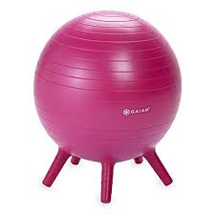
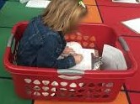
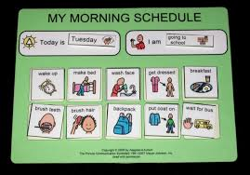
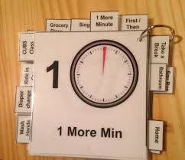
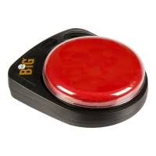
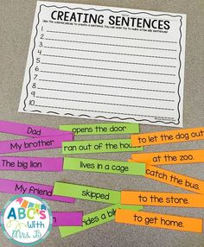
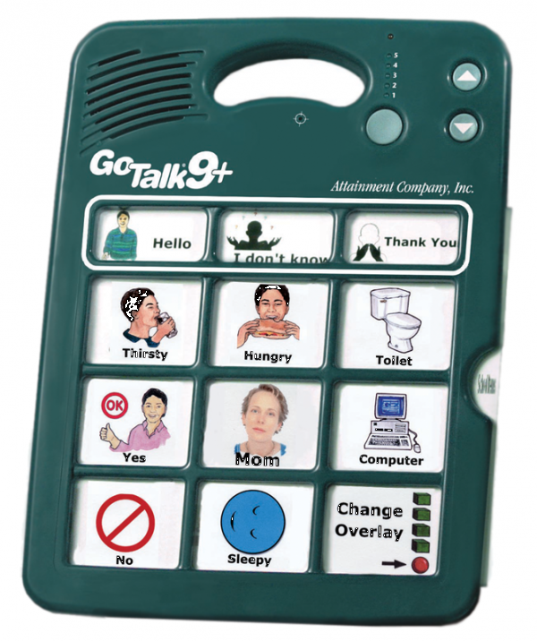
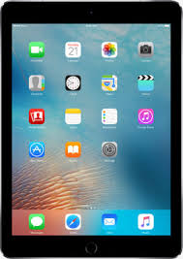
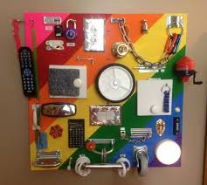
Examples of equipment in our programs

Slide 9
Support for Speech and Language Disorders
Complete AAC (Augmentative Alternative Communication) Evaluations for individual students
Design AAC systems and supports for individual students and academic programs to include low and high tech capabilities
Provide training and support for teachers/school staff/parents using a variety of communication strategies and support systems
Provide training and support for the use of various voice output devices

