Slide 1
Relationship Goals: Supporting Social Skills for Peer Relationships.
Andrea Kirkman, M.S., CCC-SLP

Slide 2
Social Language (Pragmatics) the “glue” that makes communication effective
Attention
Nonverbal Communication
Eye Contact
Body Language
Physical Appearance
Conversational skills
starting
stopping
maintaining topic
appropriateness
Breakdown & repair
persistence
alternate strategies
Emotional Regulation, Understanding, Expression
Conflict Resolution
Theory of Mind

Slide 3
Social Language
Students with developmental delays in social thinking do not intuitively learn social information the way neurotypical children do. Instead, they have to be cognitively taught how to think socially and understand the use of related social skills.
Michelle Garcia Winner

Slide 4
The CBT approach, which began in the mental health community, is steadily gaining support as a viable treatment method for individuals with ASDs who have strong language communication abilities (Lopata, Thomeer, Volker, & Nida, 2006; Reaven, Blakeley-Smith, Nichols, Dasari, Flanigan, & Hepburn, 2009). CBT provides a concrete method through which students and providers can discuss social expectations (perceptions, thoughts, and emotions) and then define social-behavioral adaptations, better known as “social skills.”
Social Communication Strategies for Adolescents With Autism
Michelle Garcia Winner, MA, CCC-SLP; Pamela J. Crooke, PhD, CCC-SLP
The ASHA Leader, January 2011, Vol. 16, 8-11. doi:10.1044/leader.FTR1.16012011.8

Slide 5
A Framework for teaching Social Skills to Students with Asperger Syndrome in the General education classroom
Direct Instruction
Contextualizing Social Skill Practice
Peer Assisted Learning
Whitby, Ogilvie, Mancil (2012) A Framework for teaching Social Skills to Students with Asperger Syndrome in the General education classroom Journal of Developmental Disabilities, (18)1, 62-72.

Slide 6
The Social Thinking-Social Communication Profile
Neurotypical Social Communicator
Nuance Challenged Social Communicator
Socially Anxious Social Communicator
Weak Interactive Social Communicator
Emerging Social Communicator
Challenged Social Communicator
Significantly Challenged Social Communicator
Resistant Social Communicator
http://www.socialthinking.com/what-is-social-thinking/social-thinking-social-communication-profile

Slide 7
Compared to typically developing children, children with autism were both
lonelier and had less complete understandings of loneliness. Although all children with autism reported having at least one friend, the quality of their friendships was poorer in terms of companionship, security, and
help. Fewer associations were found between loneliness and friendship for the autistic than for the non-autistic children, suggesting less understanding of the relation between loneliness and friendship
Bauminger, N., & Kasari, C. (2000). Loneliness and friendship in high-functioning children with autism. Child Development, 71, 447–456.

Slide 10
Individuals perceive and value relationships differently.

Slide 11
4 Steps of Communication
1. Think about other people's thoughts and feelings as well as your own.
2. Establish physical presence; enter with your body attuned to the group.
3. Think with your eyes.
4. Use your words to relate to others.

Slide 12
1. Think about other people's thoughts and feelings as well as your own.
People File
Likes
Dislikes
What do we have in common?
**Careful – don’t get stuck on your own interests
Think About You vs. Think About Me
Flexible Thinker

Slide 13
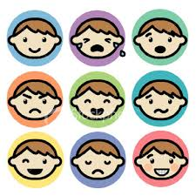
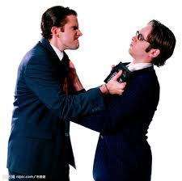
2. Establish physical presence; enter with your body attuned to the group.
Expected/Unexpected Behavior
Thoughts change Feelings change Actions
Self Awareness/Monitoring

Slide 14
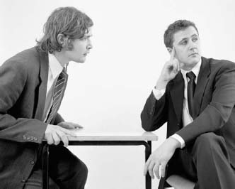
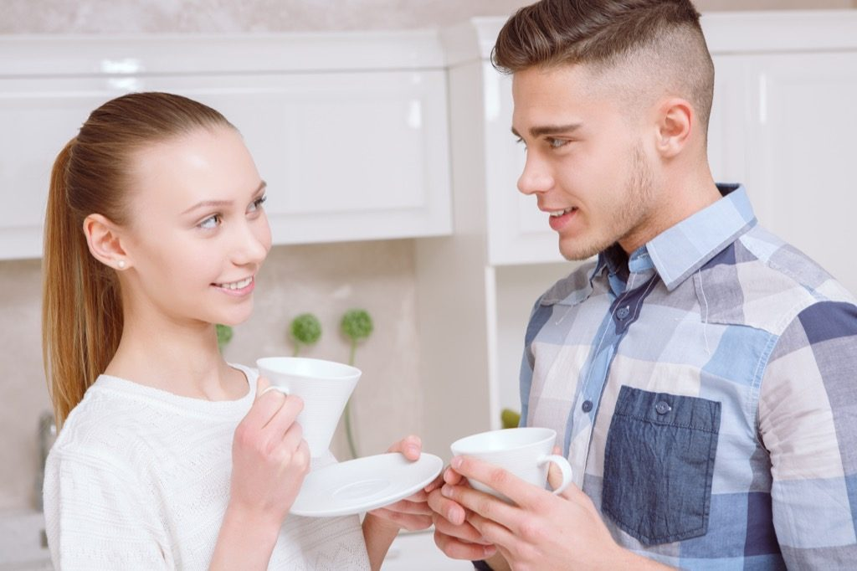
3. Think with your eyes.

Slide 15
4. Use your words to relate to others.
Conversation Train
Interview
Talk Time Scale
Inhibitory Control - suppressing inappropriate, irrelevant or automatic/habitual responses, waiting for appropriate time and place and coping with distractions

Slide 16
Dating
Parents feel
Students feel then

Slide 17
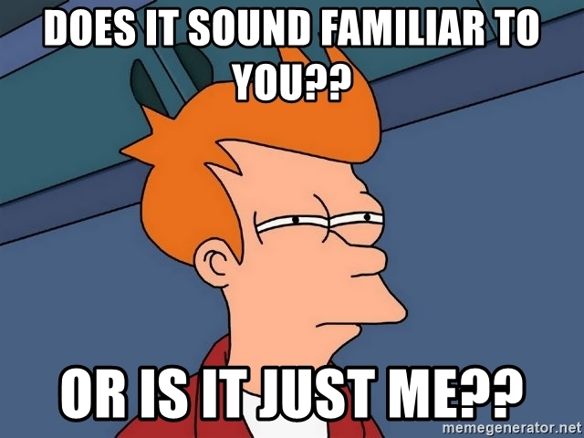
Understanding Healthy Relationships
Safety
What Do I Want
Hygiene/Appearance
Trust, Respect, Communication
Deal Breakers
Allow for Failure

Slide 18
Simple skill wins for momentum..
Can you order for yourself at a restaurant?
Can you do self care routines without a lot of reminders?
Do you text anyone who is not your mother?
Do you know how or are learning to do some basic chores around the house?
Build skills for initiative.

Slide 19
Communication in 2018

Slide 20
Social Anxiety
“Social anxiety can prevent individuals from accessing and interpreting their own social thinking information in ways that allow them to interact easily with peers.”
Michelle Winner

Slide 21
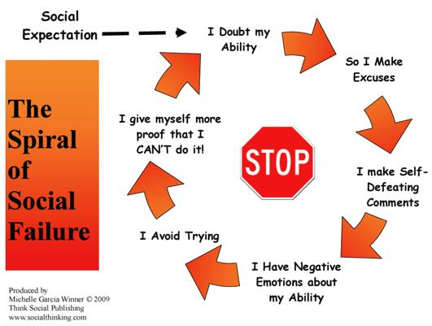

Slide 22
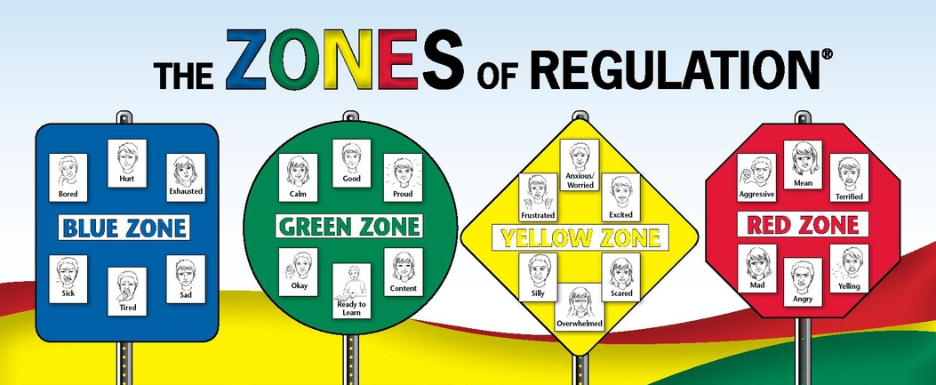

Slide 23
