Slide 2
What’s My New Role?
A Family Systems Perspective of an ASD Diagnosis and Therapeutic Needs
04.20.18
| Brandon Rodgers, PhD, LMFT |
Director of Behavioral Health – Siskin Children’s Institute
Affiliated Assistant Professor – University of Tennessee College of Medicine
| Von Poll, PhD Intern |
MFT PhD Intern – Siskin Children’s Institute
MFT PhD Student – Texas Tech University
Siskin Children's Institute works to improve the quality of life for
children with special needs and their families.

Slide 3
- What’s My New Role? -
Goals for Today:
Attendees will gain an understanding of a systemic approach when identifying the needs of a family.
Attendees will be able to identify several family role struggles commonly identified following an autism spectrum diagnosis.
Attendees will be able to identify potential resources to address therapeutic needs of a family.
SERVING CHILDREN WITH SPECIAL NEEDS AND THEIR FAMILIES SINCE 1950 | siskin.org

Slide 4
- What’s My New Role-
Disclaimer: This presentation will explore the diagnostic impact of an autism spectrum disorder through a systemic lens of the entire family. Common transitional role struggles and therapeutic needs identified by families will be discussed. Everyone’s role experience is unique and may be different. The following is provided as a collection of clinical experience shared from
families over the past 15 years.
SERVING CHILDREN WITH SPECIAL NEEDS AND THEIR FAMILIES SINCE 1950 | siskin.org

Slide 5
Goal 1:
What is a Systemic Approach?
SERVING CHILDREN WITH SPECIAL NEEDS AND THEIR FAMILIES SINCE 1950 | siskin.org

Slide 6
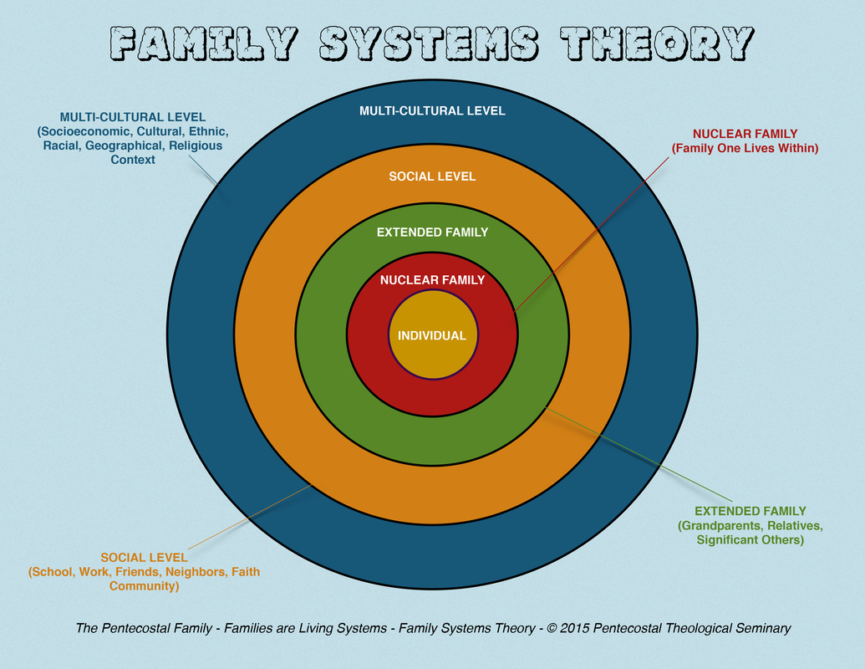
- What’s My New Role? -
Systemic Approach:
SERVING CHILDREN WITH SPECIAL NEEDS AND THEIR FAMILIES SINCE 1950 | siskin.org
Notes:
Individuals cannot be understood in isolation from one another, but rather as a part of their family, as the family is an emotional unit. Families are systems of interconnected and interdependent individuals, none of whom can be understood in isolation from the system.

Slide 7
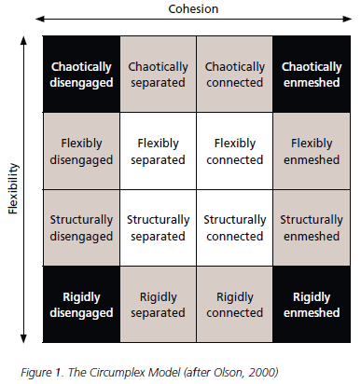
- What’s My New Role? -
Systemic Approach
Circumplex Model of Marital and Family Systems:
SERVING CHILDREN WITH SPECIAL NEEDS AND THEIR FAMILIES SINCE 1950 | siskin.org
Notes:
Individuals cannot be understood in isolation from one another, but rather as a part of their family, as the family is an emotional unit. Families are systems of interconnected and interdependent individuals, none of whom can be understood in isolation from the system.

Slide 8
Goal 2:
Family role struggles commonly identified following an autism spectrum diagnosis?
SERVING CHILDREN WITH SPECIAL NEEDS AND THEIR FAMILIES SINCE 1950 | siskin.org

Slide 9
The Day of the
Diagnosis
SERVING CHILDREN WITH SPECIAL NEEDS AND THEIR FAMILIES SINCE 1950 | siskin.org

Slide 10
- What’s My New Role? -
Reflection on One’s Developmental Trajectory of Life
Roles typically associated with a choice:
Spouse
Children
Job/Career Role
Roles we acquire
Set Expectations?
Cultural Expectations
Evolving Gender Expectations
Sibling Order Expecations
SERVING CHILDREN WITH SPECIAL NEEDS AND THEIR FAMILIES SINCE 1950 | siskin.org

Slide 11
- What’s My Role? -
In your family, who…
makes breakfast, lunch, and dinner?
cleans up after meals?
cleans the house?
transports your child to their therapy appointments?
transports your child to their medical appointments?
transports your child to school?
attends all the IEP meetings?
works or has a career outside their caretaking role?
handles the discipline issues in the family?
goes shopping for food or clothing for the family?
does homework with your child?
does the laundry?
does/did the midnight feedings?
cleaned the bottles and baby items?
calls the insurance company?
comforts the crying family member?
reads to their child?
puts their child to bed?
plays with their child?
pays the bills?
goes to teacher conferences?
gets their taxes together?
mows the yard?
takes out the garbage?
takes care of the pets?
does the dishes?
gets tires or changes the oil in the car?
fixes the broken items in the house?
changes diapers?
makes sure your finances are ok?
gets your car inspected?
tries to hold the family together?
…Feels Overwhelmed?
SERVING CHILDREN WITH SPECIAL NEEDS AND THEIR FAMILIES SINCE 1950 | siskin.org

Slide 12
- What’s My New Role? -
Five Commonly Expressed Unexpected Expert Roles:
(Experienced by Families Following a Diagnosis)
1. Research Expert
2. Family Counselor Expert
3. Special Education Expert
4. Social Advocate Expert
5. Time & Self-Care Expert
SERVING CHILDREN WITH SPECIAL NEEDS AND THEIR FAMILIES SINCE 1950 | siskin.org

Slide 13
- What’s My New Role? -
Role 1 - Research Expert:
Learning about an ASD Diagnosis
What “Caused” Autism: Myths and Facts
What Treatments are Best
What New Information is Important
What Books/Websites do I Trust
SERVING CHILDREN WITH SPECIAL NEEDS AND THEIR FAMILIES SINCE 1950 | siskin.org

Slide 14
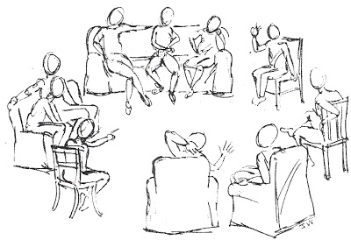
- What’s My New Role? -
Role 2 - Family Counselor Expert:
Monitoring Needs and Wants of My Family
Systemic/Stress Impact of the Diagnosis on the Family
Overlooked Siblings
Externalizing an ASD Diagnosis (How does ASD Impact...)
How is My Child…but also How is My Family?
Kubler Ross – Stages of Grief
SERVING CHILDREN WITH SPECIAL NEEDS AND THEIR FAMILIES SINCE 1950 | siskin.org

Slide 15
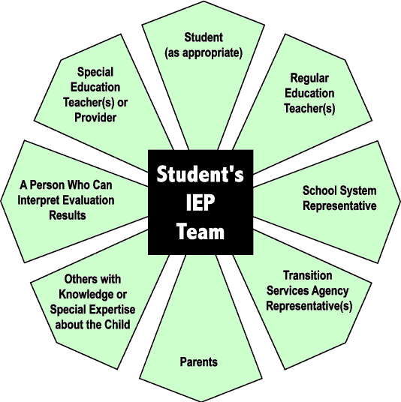
- What’s My New Role? -
Role 3 - Special Education Expert:
Learning IEPs and 504s
Navigating Relationships with IEP Team Members
What Services are Best
Modifications vs Accommodations
What is FAPE?
In School vs Outpatient
SERVING CHILDREN WITH SPECIAL NEEDS AND THEIR FAMILIES SINCE 1950 | siskin.org

Slide 16
- What’s My New Role? -
Role 4 - Social Advocate Expert:
Educating a Spouse
Divorce Rate and Commitment to New Roles
Educating Grandparents, Siblings, Aunts, Uncles, etc.
Sharing News to other Friends/Family Members
Defending Perceived “Bad Parenting” by others in Public
Fulfilling Role as the Child Expert of Your Child’s History & Development and Educating Teachers, Doctors, Therapists, etc.
SERVING CHILDREN WITH SPECIAL NEEDS AND THEIR FAMILIES SINCE 1950 | siskin.org

Slide 17
- What’s My New Role? -
Role 5 - Time & Self-Care Expert:
Time Committed to Multiple Therapy Appointments, Doctor’s Appointments, School, Events, etc.
Feeling Worn Down
Monitoring General Self-Care
Taking Time for Parental Needs
Places for Parents Night Out
Help Self to Help Others
Caring for the Caregiver (100 Day Kit)
SERVING CHILDREN WITH SPECIAL NEEDS AND THEIR FAMILIES SINCE 1950 | siskin.org

Slide 18
- What’s My New Role? -
Experiential Group Exercise: The Great Balancing Act
SERVING CHILDREN WITH SPECIAL NEEDS AND THEIR FAMILIES SINCE 1950 | siskin.org

Slide 19
Goal 3:
Potential Resources
SERVING CHILDREN WITH SPECIAL NEEDS AND THEIR FAMILIES SINCE 1950 | siskin.org

Slide 20
- What’s My New Role? -
Examine Your Own Systems
National Level:
Clinical Trials (e.g., SPARK) & Advocacy
Resource Websites
Autismspeaks.org (100 Day Kit)
AAP.org
Regional/Local Resources:
Chattanooga Autism Center, Siskin Children’s Institute, Vanderbilt, Marcus Institute, Support Groups, Churches, MD, OT, PT, Speech, Family Voices, Family Therapy/Counseling
Family:
Balance - Siblings, Marriage, Partners, Parenting, Friends, and General Relationships
Individual:
Time for Self
SERVING CHILDREN WITH SPECIAL NEEDS AND THEIR FAMILIES SINCE 1950 | siskin.org

Slide 21
Questions?
SERVING CHILDREN WITH SPECIAL NEEDS AND THEIR FAMILIES SINCE 1950 | siskin.org

