Slide 1
Child Directed Play Skills for Young Children on the Autism Spectrum: Tailored for Teachers
John Paul Abner, Ph.D.
Milligan College
PCIT International Certified Master Trainer

Slide 2
Many interventions use Child Directed Play
Floor Time
Incredible Years
Parent Child Interaction Therapy
  Promising treatment for children on the autism spectrum with disruptive behavior issues.

Slide 3
What’s so different about PCIT?
Targeted for children ages 2 – 7
It is a “doing” therapy.
Hand’s on treatment approach
Parents/caregivers are trained in skills during therapy that are easy to take home.
It is not a parenting class
  Specific set of skills to work with specific set of problems.
Therapists are in the role of coach and educator.
It works!

Slide 4
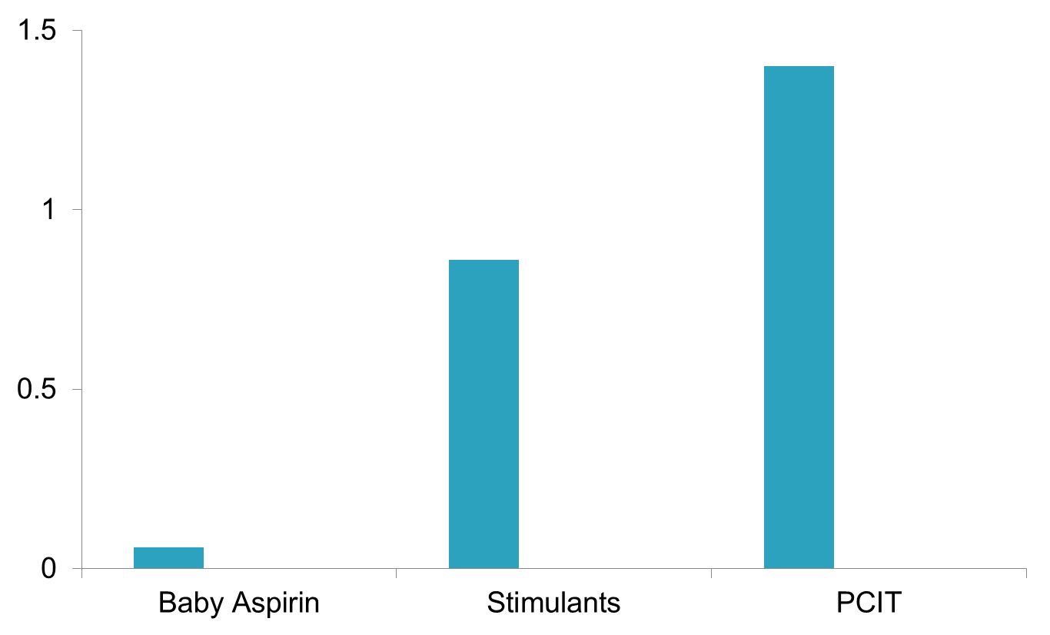
PCIT Effect Size
1.43
ASTRONOMICAL
0.9
Cohen’s d
0.8 Large
0.5 Medium
0.1
0.2 Small
(Rosenthal et al., 1990)
(Connor et al., 2002)
(Schuhmann et al., 1998)
Notes:
Use of baby aspirin to prevent heart disease. Rosenthal (1990, American Psychologist, 45, 775-777.) used an example where a treatment (a small daily dose of aspirin) lowered patients’ death rate so much that the researchers conducting this research the research prematurely and told the participants who were in the control condition to start taking a baby aspirin every day. So, how large was the effect of the baby aspirin? As an odds ratio it was 1.83 – that is, the odds of a heart attack were 1.83 times higher in the placebo group than in the aspirin group. As a proportion of variance explained the effect size was .0011 (about one tenth of one percent).
Stimulants affect on ADHD.
So, effect size refers to the magnitude of the treatment effect.
Here, the difference between pre-tx mean and 4-6 year follow-up mean is 1.43.
(According to Cohen’s interpretive guidelines, and ES of .80 is a large effect. So a finding of an ES of 1.43 is an extremely large effect).
Cohen’s Effect Sizes
Small = .20
Medium = .50
Large = .80
1.43 = ASTRONOMICAL!!!!

Slide 5
If PCIT is so great, then why haven't I heard about it before?

Slide 6
PCIT is comprised of two very distinct components

Slide 7
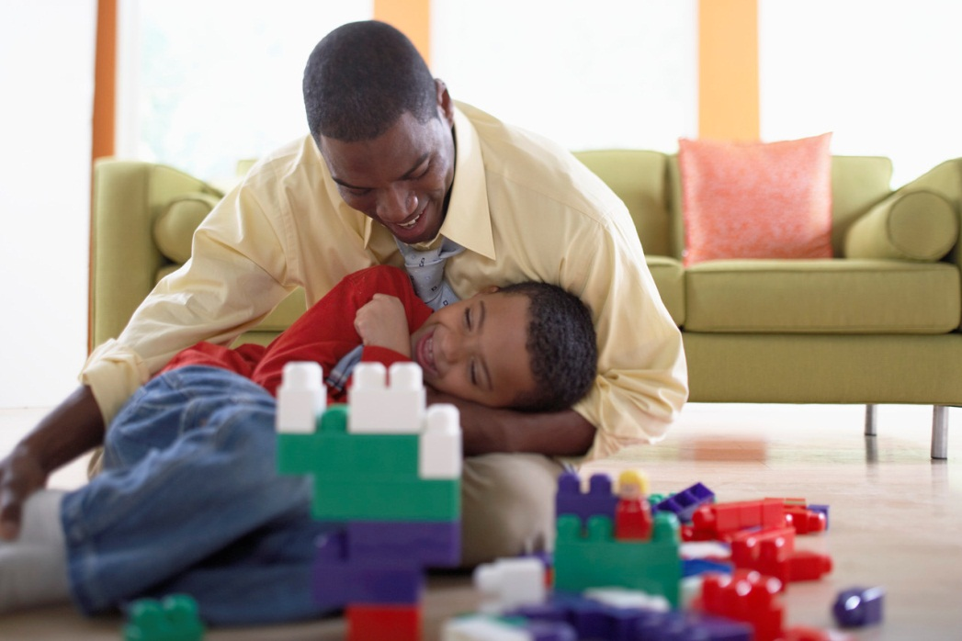
Child Directed Interaction (CDI)
Developmental Play Skills
Parent as play therapist.
Five minutes a day
Child leads the play.

Slide 8
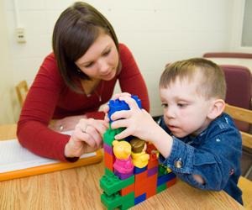
Child directed interaction helps parents and teachers of children with autism spectrum disorder to get into their child’s world

Slide 9
Child Directed Interaction
Improves caregiver’s plays skills.
Improves child’s self-esteem.
Promotes warmth in the parent-child relationship.
Promotes language skills.
Promotes concept formation.
Helps the caregiver appreciate the child more.
Increases the caregiver’s self-esteem
Gives child an appropriate place to lead

Slide 10

Parent Directed Interaction
Structured discipline techniques.
Teaches the child to obey caregivers.
Modifies problematic behaviors

Slide 11

The Importance of

Slide 12
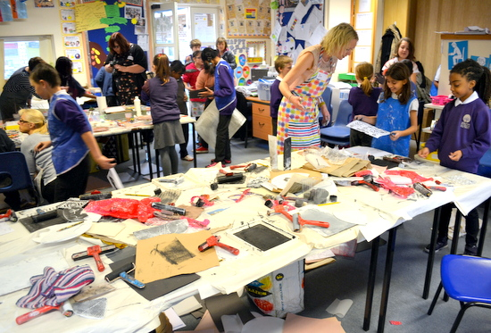
Most teachers don’t have much time for long individual interactions.

Slide 13
Child Directed Interaction Skills
Avoid Skills
For Teachers: we change this to “Reduce” skills

Slide 14

Avoid criticism
Doesn’t work to decrease bad behaviors
Often increases the criticized behaviors
May lower the child’s self-esteem
Creates an unpleasant interaction
Tell a child what to do rather than what not to do

Slide 15
Reduce commands.
Commands lead the play.
Commands can lead to unpleasant interactions if child disobeys.
Two types of commands.
  Direct: “Sit down” “Put that away”
  Indirect:
    “Why don’t you sit here?
    “Let’s clean up the room.”

Slide 16
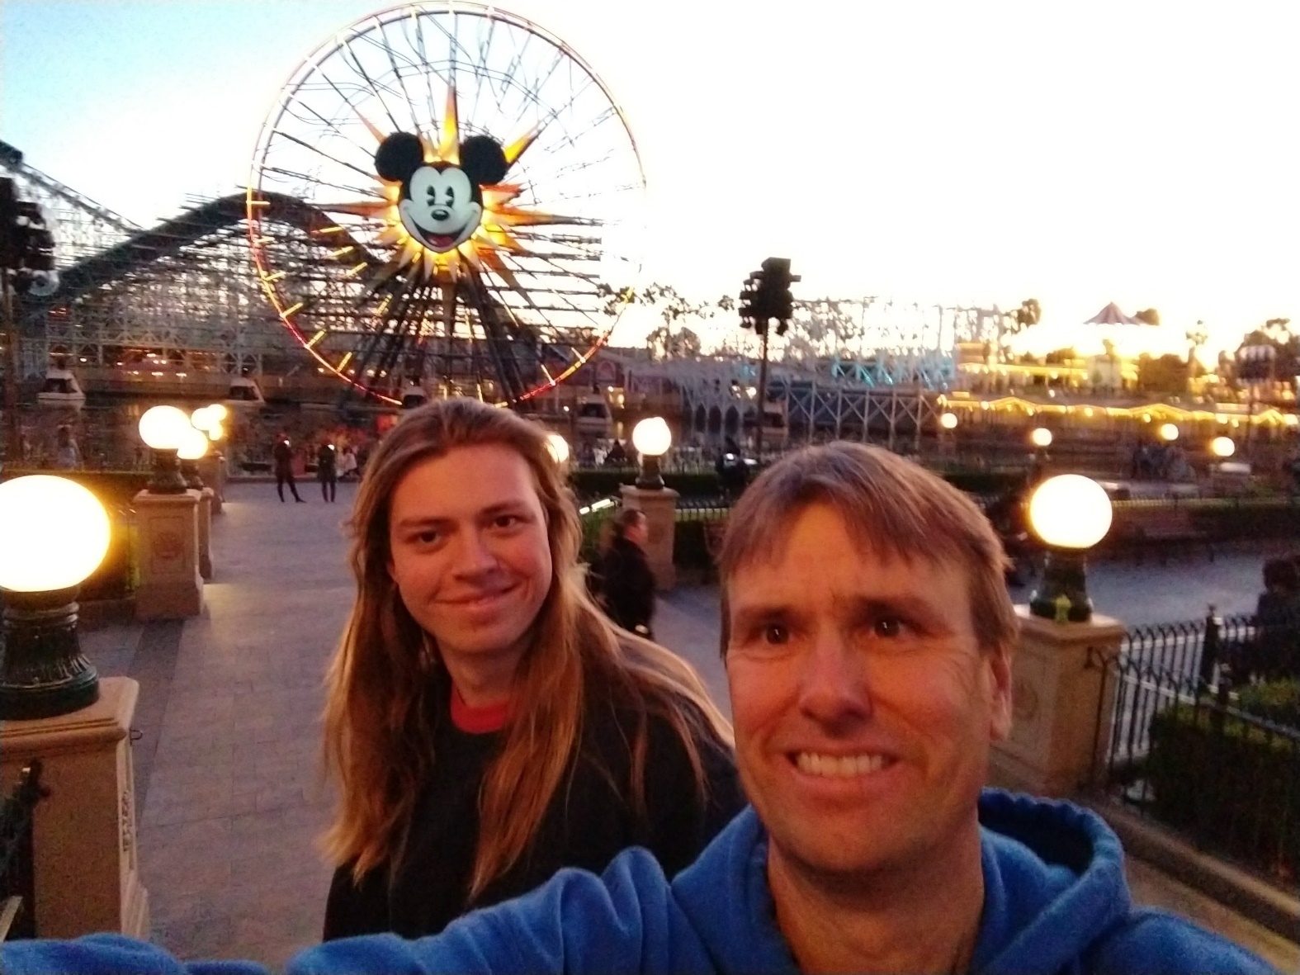
Reduce questions

Slide 17

Reduce questions.
Leads the play instead of following it
Questions are often hidden commands or suggestions.
May seem like you aren’t listening or disagree with the child
May suggest disapproval
Notes:
Ever have one of those conversations with your spouse or significant other in front of the television
Our apartment you can’t hear around the kitchen. After third question, I just want to say let’s stop sit down. I just wan t to say stop

Slide 18
CDI Skills
Pride Skills

Slide 19

Pride skills
Praise
Reflect
Imitate
Describe
Enjoy

Slide 20
Give Labeled Praise to appropriate behavior.
Make your praise highly specific and understandable
  “That’s terrific counting”
  “I like the way you are playing so quietly.”
  “You did a nice job on that building.”
  “Your design is pretty.”
  “Thank you for showing the colors to me.”

Slide 21
Why praise?
Causes the behavior to increase
Lets the child know what you like
Increases the child’s self-esteem
Adds to warmth of the relationship
Makes both caregiver and child feel good

Slide 22
“But children on the spectrum can’t learn from social reinforcement.”
WRONG!!!!
Kids on the spectrum have difficulty understanding and expressing social communication.
Social reinforcement that is specific and understandable can have great influence on a child on the spectrum.

Slide 23
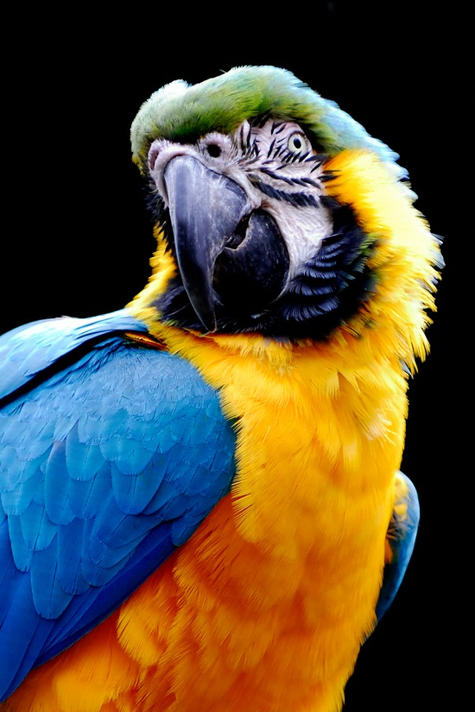
Reflect appropriate talk.
Child: “I made a star.”
caregiver: ”Yes, you made a star.”
Child: “I like to play with this castle.”
caregiver: “This is a fun castle to play with.”

Slide 24
Why Reflect?
Shows the child you are really listening
Demonstrates acceptance and understanding of the child
Improves child’s speech
Increases verbal communication

Slide 25

Imitate appropriate play
Child: “I’m putting baby to bed.”
caregiver: “I’ll put sister to bed, too.
Child: (Uses a dump truck.)
caregiver: (Uses a dump truck)

Slide 26
Why Imitate?
Lets child lead
Approves child’s choice of play
Shows child that you are involved
Teaches child how to play with others (e.g. basis of taking turns)
Tends to increase the child’s imitation of what you do
Teaches valuable social skills

Slide 27
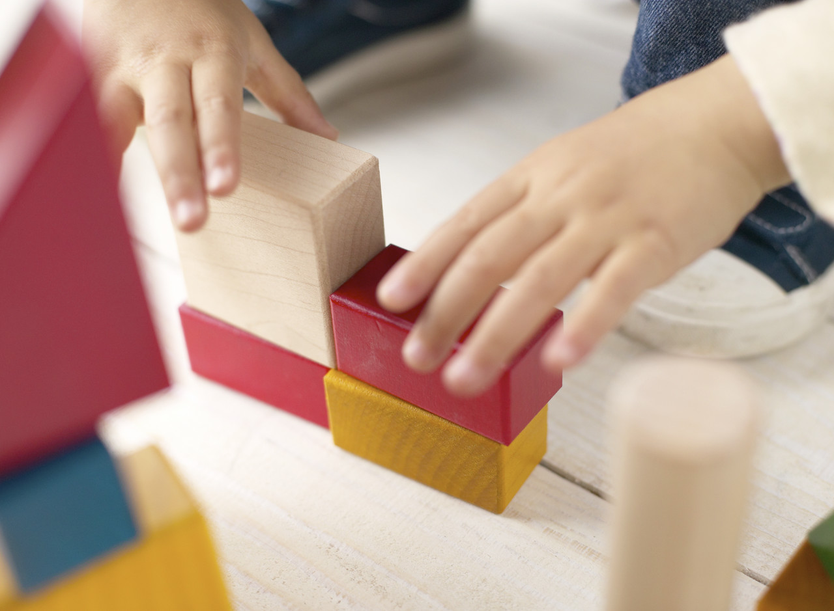
Describe appropriate behavior.
“You picked up the red block.”
“You’re making a tower.”

Slide 28

Why Describe?
allows child to lead
shows child that you are interested
teaches concepts
models speech
holds child’s attention
organizes child’s thoughts about play

Slide 29
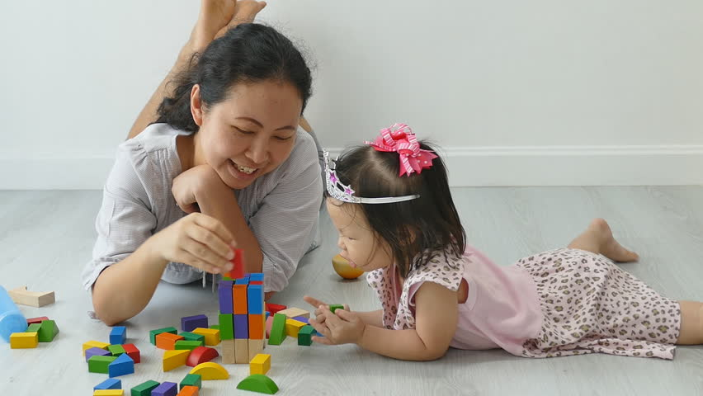
Enjoy
Let’s child know that you enjoy spending time with the caregiver
Increases the warmth of play.

Slide 30
“Owen was noticing our desire 24/7 to ‘fix’ him, but you can’t spend your life trying to fix someone. It’s not an appropriate relationship between a caregiver and a child. We realized we were not finding joy together, and that’s a big part of this equation.”

Slide 31
Selective attention
Avoiding showering a child who is misbehaving with attention.
Seek for the positive opposite to praise.
Magic Fun strategy

Slide 32
CDI is an extremely verbal interaction
10 descriptions
10 reflections
10 labeled praises

Slide 33
Toys that work well with CDI
Construction toys
Creative toys
Non messy art activities (crayons, etc.)
Playskool barns, house, etc.

Slide 34
Toys to avoid during CDI
Board games
Pretend talk toys
Toys that encourage rough play.
Toys that encourage aggressive play.
Toys that encourage messy play.

Slide 35
Time to Play
caregiver
Child
Pick a toy
Role play for 5 minutes each in each role.
Child misbehaves in final minute.

Slide 36

Final Tips: Embrace Affinities!
“What we began to realize is that just by loving what he loved, we were signaling to him a whole basket of things that parents are traditionally able to signal to their children. And the more we did that, the more he opened up.”

Slide 37
Final Tips: Expansion Through Play
Be cognizant of toy selection and topics as a way of engagement
  If needed, introduce familiar toys and topics for initial engagement/connection then DRO
  Include toys where caregivers have to inherently help.
Always look to expand play repertoire any chance you get!
Incorporate the fixed interest and new toy (ex. Feeding the baby horse or making the baby horse a barn)
Shaping is your friend!
  Helicopter propeller to fly-by’s
Notes:
Preferred toys at the end of session
big question is how fixated is child on toy—essentially ignoring parent. then may need to timeout the toy ro work to introduce other toys and gauge reaction.

Slide 38
ASD Symptoms: DSM-IV-TR | Positive Opposite Behaviors
Impairment in use of nonverbal behaviors Eye contact Facial expression Body postures Gestures | Good job looking at me.
Failure to develop peer relationships appropriate to developmental level | Good job playing with your brother.
Lack of spontaneous seeking to share enjoyment, interests or achievements with others Lack of showing Lack of bringing Lack of pointing out objects of interest | Thank you for showing me your toy. I like how you brought your shoe to me. Thank you for pointing to the toy on the shelf.
No social or emotional reciprocity | I like it when we play together/share.
Notes:
Target coaching based on limitations consistent with constellations of behavior

Slide 39
ASD Target Behaviors: ADOS (Modules 1 &2) | Praises
Response to name | Thank you for looking at me when I said your name.
Response to touch from others | I like it when you let me hug you/hold your hand.
Response to joint attention (follows another’s gaze with or without accompanied pointing) | Good job looking at what I’m looking at.
Affect | I like it when you smile.
Initiate joint attention | Thanks for getting my attention. I like how you got me to look at the toy.
Shared enjoyment | I like it when we play together.
Requesting | I like how you asked with your words/hands
Smiling in response to calling in a way that implies physical contact (e.g., “I’m gonna get you!”) | I like how you’re smiling at me.
Gestures directed at others Points with index finger Open-handed reach Hands item to another person | Thank you for pointing/reaching. Thank you for handing me the toy.
Facial expressions directed at others | I like how you’re smiling at me.
Gaze directed at others | I like it when you look at me.
Imitation of familiar actions | I like how you’re doing what I’m doing.

